Slide 1
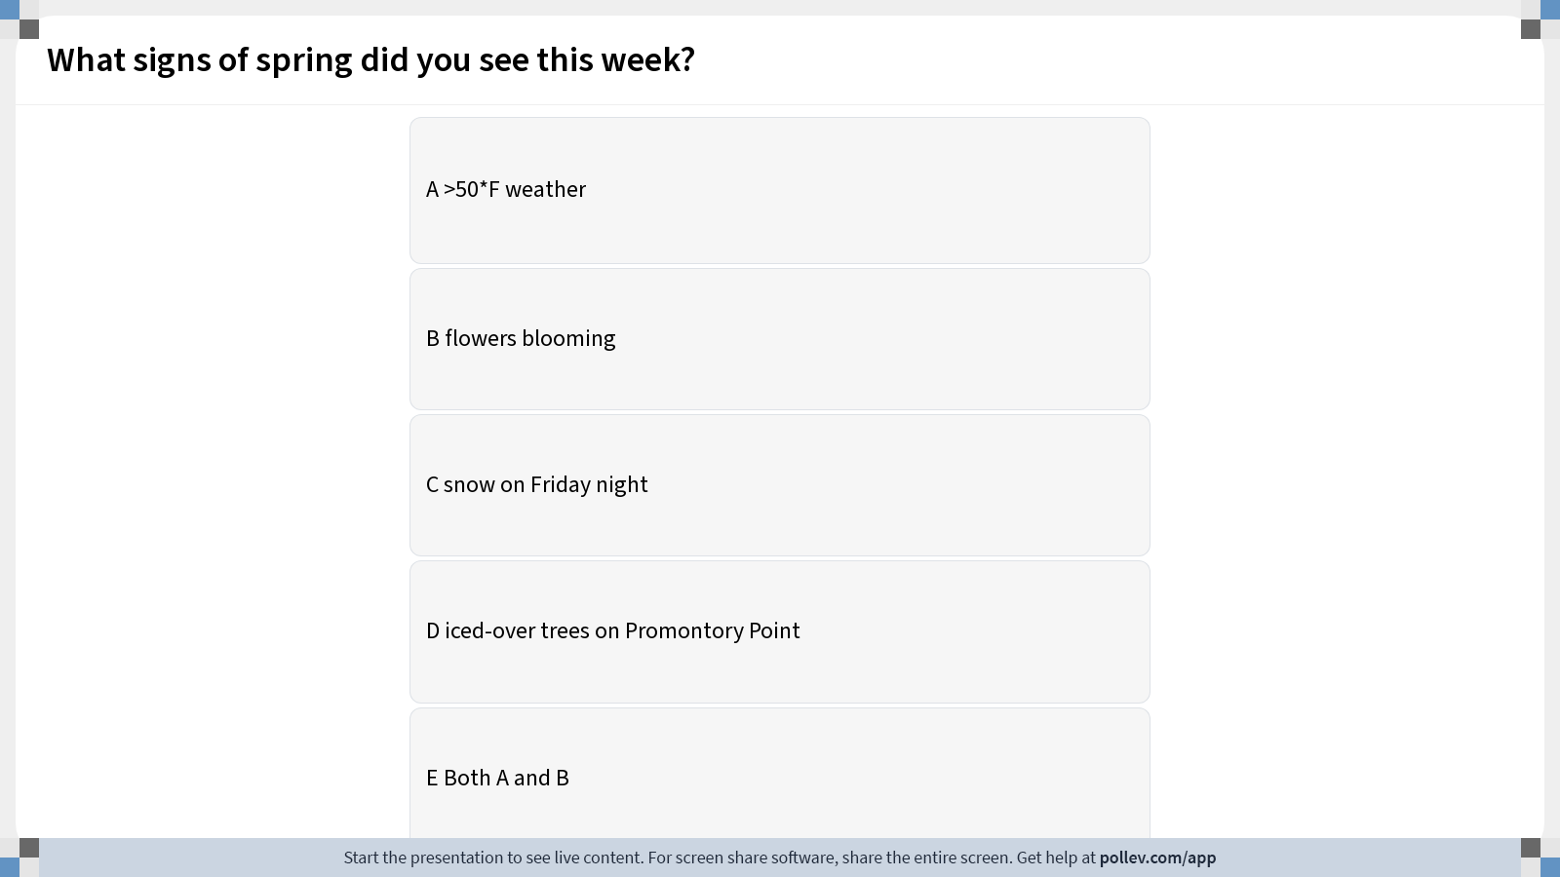
Notes:
Do not modify the notes in this section to avoid tampering with the Poll Everywhere activity. More info at polleverywhere.com/support What signs of spring did you see this week?
https://www.polleverywhere.com/multiple_choice_polls/92CIyCrGhOx0uPihSdrgk?display_state=instructions&activity_state=opened&state=opened&flow=Instructor&onscreen=persist

Slide 2
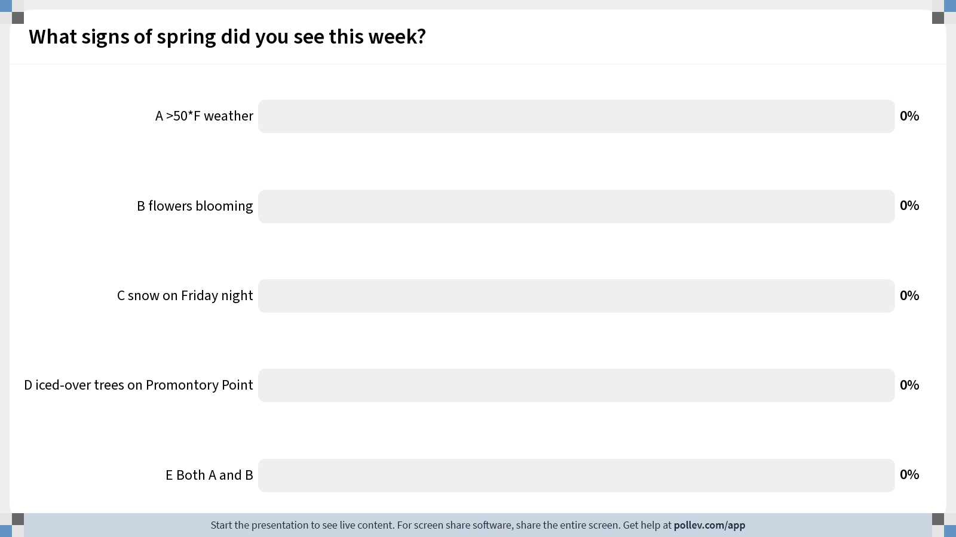
Notes:
Do not modify the notes in this section to avoid tampering with the Poll Everywhere activity. More info at polleverywhere.com/support What signs of spring did you see this week?
https://www.polleverywhere.com/multiple_choice_polls/92CIyCrGhOx0uPihSdrgk?display_state=chart&activity_state=closed&state=closed&flow=Instructor&onscreen=persist

Slide 3
Notes:
Do not modify the notes in this section to avoid tampering with the Poll Everywhere activity. More info at polleverywhere.com/support What signs of spring did you see this week?
https://www.polleverywhere.com/multiple_choice_polls/92CIyCrGhOx0uPihSdrgk?display_state=chart&activity_state=closed&display=correctness&state=closed&flow=Instructor&onscreen=persist

Slide 4
Fundamentals of Ecology
Week 9, Ecology Lecture 7
Cara Brook
February 27, 2024

Slide 5
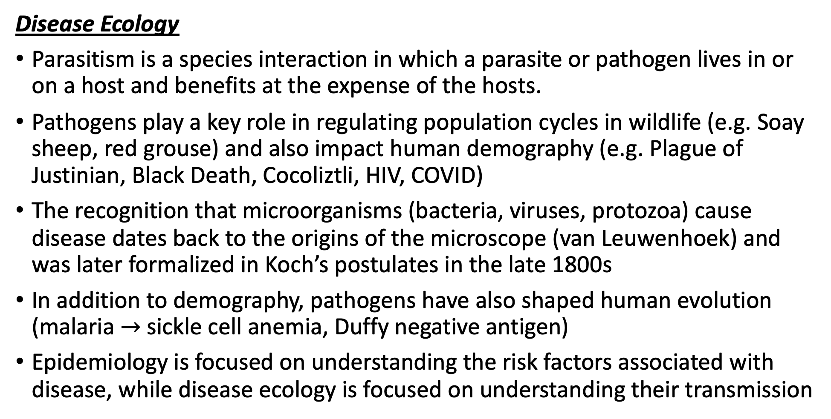
Let’s recap a bit!
Disease Ecology
Parasitism is a species interaction in which a parasite or pathogen lives in or on a host and benefits at the expense of the hosts.
Pathogens play a key role in regulating population cycles in wildlife (e.g. Soay sheep, red grouse) and also impact human demography (e.g. Plague of Justinian, Black Death, Cocoliztli, HIV, COVID)
The recognition that microorganisms (bacteria, viruses, protozoa) cause disease dates back to the origins of the microscope (van Leuwenhoek) and was later formalized in Koch’s postulates in the late 1800s
In addition to demography, pathogens have also shaped human evolution (malaria $→$ sickle cell anemia, Duffy negative antigen)
Epidemiology is focused on understanding the risk factors associated with disease, while disease ecology is focused on understanding their transmission
Disease Ecology
We learned about extensions to the SIR model that can be made to better represent diverse types of pathogens (e.g. dynamics different from classic measles).
These extensions included incorporating inherited maternal immunity into a disease model (important in the case of natural vs. vaccinated immunity in mothers), as well as modeling different types of pathogen transmission.
Environmental disease transmission occurs when the pathogen is maintained outside the host in an environmental reservoir. We learned a few approaches to modeling this type of pathogen. Example: cholera, with water-borne transmission.
Vertical transmission occurs when a pathogen is passed mother-to-infant in utero. We learned how to model this in the case of HIV- and also learned a few details about this pathogen.
Vector-borne transmission occurs when a pathogen is transmitted via blood-feeding arthropod (tick, flea, mosquito). We learned the specifics of how vector-borne disease are modeled in the case of malaria.

Slide 6
Let’s recap a bit!
Disease Ecology
Parasitism is a species interaction in which a parasite or pathogen lives in or on a host and benefits at the expense of the hosts.
Pathogens play a key role in regulating population cycles in wildlife (e.g. Soay sheep, red grouse) and also impact human demography (e.g. Plague of Justinian, Black Death, Cocoliztli, HIV, COVID)
The recognition that microorganisms (bacteria, viruses, protozoa) cause disease dates back to the origins of the microscope (van Leuwenhoek) and was later formalized in Koch’s postulates in the late 1800s
In addition to demography, pathogens have also shaped human evolution (malaria $→$ sickle cell anemia, Duffy negative antigen)
Epidemiology is focused on understanding the risk factors associated with disease, while disease ecology is focused on understanding their transmission
Disease Ecology
We learned about extensions to the SIR model that can be made to better represent diverse types of pathogens (e.g. dynamics different from classic measles).
These extensions included incorporating inherited maternal immunity into a disease model (important in the case of natural vs. vaccinated immunity in mothers), as well as modeling different types of pathogen transmission.
Environmental disease transmission occurs when the pathogen is maintained outside the host in an environmental reservoir. We learned a few approaches to modeling this type of pathogen. Example: cholera, with water-borne transmission.
Vertical transmission occurs when a pathogen is passed mother-to-infant in utero. We learned how to model this in the case of HIV- and also learned a few details about this pathogen.
Vector-borne transmission occurs when a pathogen is transmitted via blood-feeding arthropod (tick, flea, mosquito). We learned the specifics of how vector-borne disease are modeled in the case of malaria.

Slide 7
Let’s recap a bit!
Disease Ecology
Parasitism is a species interaction in which a parasite or pathogen lives in or on a host and benefits at the expense of the hosts.
Pathogens play a key role in regulating population cycles in wildlife (e.g. Soay sheep, red grouse) and also impact human demography (e.g. Plague of Justinian, Black Death, Cocoliztli, HIV, COVID)
The recognition that microorganisms (bacteria, viruses, protozoa) cause disease dates back to the origins of the microscope (van Leuwenhoek) and was later formalized in Koch’s postulates in the late 1800s
In addition to demography, pathogens have also shaped human evolution (malaria $→$ sickle cell anemia, Duffy negative antigen)
Epidemiology is focused on understanding the risk factors associated with disease, while disease ecology is focused on understanding their transmission
Disease Ecology
We learned about extensions to the SIR model that can be made to better represent diverse types of pathogens (e.g. dynamics different from classic measles).
These extensions included incorporating inherited maternal immunity into a disease model (important in the case of natural vs. vaccinated immunity in mothers), as well as modeling different types of pathogen transmission.
Environmental disease transmission occurs when the pathogen is maintained outside the host in an environmental reservoir. We learned a few approaches to modeling this type of pathogen. Example: cholera, with water-borne transmission.
Vertical transmission occurs when a pathogen is passed mother-to-infant in utero. We learned how to model this in the case of HIV- and also learned a few details about this pathogen.
Vector-borne transmission occurs when a pathogen is transmitted via blood-feeding arthropod (tick, flea, mosquito). We learned the specifics of how vector-borne disease are modeled in the case of malaria.

Slide 8
Let’s recap a bit!
Disease Ecology
Parasitism is a species interaction in which a parasite or pathogen lives in or on a host and benefits at the expense of the hosts.
Pathogens play a key role in regulating population cycles in wildlife (e.g. Soay sheep, red grouse) and also impact human demography (e.g. Plague of Justinian, Black Death, Cocoliztli, HIV, COVID)
The recognition that microorganisms (bacteria, viruses, protozoa) cause disease dates back to the origins of the microscope (van Leuwenhoek) and was later formalized in Koch’s postulates in the late 1800s
In addition to demography, pathogens have also shaped human evolution (malaria $→$ sickle cell anemia, Duffy negative antigen)
Epidemiology is focused on understanding the risk factors associated with disease, while disease ecology is focused on understanding their transmission
Disease Ecology
We learned about extensions to the SIR model that can be made to better represent diverse types of pathogens (e.g. dynamics different from classic measles).
These extensions included incorporating inherited maternal immunity into a disease model (important in the case of natural vs. vaccinated immunity in mothers), as well as modeling different types of pathogen transmission.
Environmental disease transmission occurs when the pathogen is maintained outside the host in an environmental reservoir. We learned a few approaches to modeling this type of pathogen. Example: cholera, with water-borne transmission.
Vertical transmission occurs when a pathogen is passed mother-to-infant in utero. We learned how to model this in the case of HIV- and also learned a few details about this pathogen.
Vector-borne transmission occurs when a pathogen is transmitted via blood-feeding arthropod (tick, flea, mosquito). We learned the specifics of how vector-borne disease are modeled in the case of malaria.

Slide 9
Let’s recap a bit!
Disease Ecology
Parasitism is a species interaction in which a parasite or pathogen lives in or on a host and benefits at the expense of the hosts.
Pathogens play a key role in regulating population cycles in wildlife (e.g. Soay sheep, red grouse) and also impact human demography (e.g. Plague of Justinian, Black Death, Cocoliztli, HIV, COVID)
The recognition that microorganisms (bacteria, viruses, protozoa) cause disease dates back to the origins of the microscope (van Leuwenhoek) and was later formalized in Koch’s postulates in the late 1800s
In addition to demography, pathogens have also shaped human evolution (malaria $→$ sickle cell anemia, Duffy negative antigen)
Epidemiology is focused on understanding the risk factors associated with disease, while disease ecology is focused on understanding their transmission
Disease Ecology
We learned about extensions to the SIR model that can be made to better represent diverse types of pathogens (e.g. dynamics different from classic measles).
These extensions included incorporating inherited maternal immunity into a disease model (important in the case of natural vs. vaccinated immunity in mothers), as well as modeling different types of pathogen transmission.
Environmental disease transmission occurs when the pathogen is maintained outside the host in an environmental reservoir. We learned a few approaches to modeling this type of pathogen. Example: cholera, with water-borne transmission.
Vertical transmission occurs when a pathogen is passed mother-to-infant in utero.
Vector-borne transmission occurs when a pathogen is transmitted via blood-feeding arthropod (tick, flea, mosquito). We learned the specifics of how vector-borne disease are modeled in the case of malaria.

Slide 10
Let’s recap a bit!
Disease Ecology
Parasitism is a species interaction in which a parasite or pathogen lives in or on a host and benefits at the expense of the hosts.
Pathogens play a key role in regulating population cycles in wildlife (e.g. Soay sheep, red grouse) and also impact human demography (e.g. Plague of Justinian, Black Death, Cocoliztli, HIV, COVID)
The recognition that microorganisms (bacteria, viruses, protozoa) cause disease dates back to the origins of the microscope (van Leuwenhoek) and was later formalized in Koch’s postulates in the late 1800s
In addition to demography, pathogens have also shaped human evolution (malaria $→$ sickle cell anemia, Duffy negative antigen)
Epidemiology is focused on understanding the risk factors associated with disease, while disease ecology is focused on understanding their transmission
Disease Ecology
We learned about extensions to the SIR model that can be made to better represent diverse types of pathogens (e.g. dynamics different from classic measles).
These extensions included incorporating inherited maternal immunity into a disease model (important in the case of natural vs. vaccinated immunity in mothers), as well as modeling different types of pathogen transmission.
Environmental disease transmission occurs when the pathogen is maintained outside the host in an environmental reservoir. We learned a few approaches to modeling this type of pathogen. Example: cholera, with water-borne transmission.
Vertical transmission occurs when a pathogen is passed mother-to-infant in utero.
Vector-borne transmission occurs when a pathogen is transmitted via blood-feeding arthropod (tick, flea, mosquito). We learned the specifics of how vector-borne disease are modeled in the case of malaria.

Slide 11
Let’s recap a bit!
Disease Ecology
We explored advances in malaria modeling, starting with the simplest Ross model, then adding a mosquito incubation period in the MacDonald model, then adding a human incubation period in the Anderson and May model.
Incorporation of the mosquito incubation period in the MacDonald model led to the insight that the survival of the female mosquito is a weak point in the malaria transmission cycle, which inspired decades of WHO malaria control via spraying of the insecticide DDT.
We learned terminology for zoonotic diseases, those transmitted from wildlife reservoirs to human spillover hosts.
Spillback occurs when pathogens transmit from the spillover host back to the reservoir that sourced the infection, as in the case of mink transmission of SARS-CoV-2 to humans.
We can classify pathogens into stage I-V based on their R₀ in the human population. Zoonotic pathogens encompass stages II-IV.

Slide 12
Let’s recap a bit!
Disease Ecology
We explored advances in malaria modeling, starting with the simplest Ross model, then adding a mosquito incubation period in the MacDonald model, then adding a human incubation period in the Anderson and May model.
Incorporation of the mosquito incubation period in the MacDonald model led to the insight that the survival of the female mosquito is a weak point in the malaria transmission cycle, which inspired decades of WHO malaria control via spraying of the insecticide DDT.
We learned terminology for zoonotic diseases, those transmitted from wildlife reservoirs to human spillover hosts.
Spillback occurs when pathogens transmit from the spillover host back to the reservoir that sourced the infection, as in the case of mink transmission of SARS-CoV-2 to humans.
We can classify pathogens into stage I-V based on their R₀ in the human population. Zoonotic pathogens encompass stages II-IV.

Slide 13
Let’s recap a bit!
Disease Ecology
We explored advances in malaria modeling, starting with the simplest Ross model, then adding a mosquito incubation period in the MacDonald model, then adding a human incubation period in the Anderson and May model.
Incorporation of the mosquito incubation period in the MacDonald model led to the insight that the survival of the female mosquito is a weak point in the malaria transmission cycle, which inspired decades of WHO malaria control via spraying of the insecticide DDT.
We learned terminology for zoonotic diseases, those transmitted from wildlife reservoirs to human spillover hosts.
Spillback occurs when pathogens transmit from the spillover host back to the reservoir that sourced the infection, as in the case of mink transmission of SARS-CoV-2 to humans.
We can classify pathogens into stage I-V based on their R₀ in the human population. Zoonotic pathogens encompass stages II-IV.

Slide 14
Let’s recap a bit!
Disease Ecology
We explored advances in malaria modeling, starting with the simplest Ross model, then adding a mosquito incubation period in the MacDonald model, then adding a human incubation period in the Anderson and May model.
Incorporation of the mosquito incubation period in the MacDonald model led to the insight that the survival of the female mosquito is a weak point in the malaria transmission cycle, which inspired decades of WHO malaria control via spraying of the insecticide DDT.
We learned terminology for zoonotic diseases, those transmitted from wildlife reservoirs to human spillover hosts.
Spillback occurs when pathogens transmit from the spillover host back to the reservoir that sourced the infection, as in the case of mink transmission of SARS-CoV-2 to humans.
We can classify pathogens into stage I-V based on their R₀ in the human population. Zoonotic pathogens encompass stages II-IV.

Slide 15
Let’s recap a bit!
Disease Ecology
We explored advances in malaria modeling, starting with the simplest Ross model, then adding a mosquito incubation period in the MacDonald model, then adding a human incubation period in the Anderson and May model.
Incorporation of the mosquito incubation period in the MacDonald model led to the insight that the survival of the female mosquito is a weak point in the malaria transmission cycle, which inspired decades of WHO malaria control via spraying of the insecticide DDT.
We learned terminology for zoonotic diseases, those transmitted from wildlife reservoirs to human spillover hosts.
Spillback occurs when pathogens transmit from the spillover host back to the reservoir that sourced the infection, as in the case of mink transmission of SARS-CoV-2 to humans.
We can classify pathogens into stage I-V based on their R₀ in the human population. Zoonotic pathogens encompass stages II-IV.

Slide 16
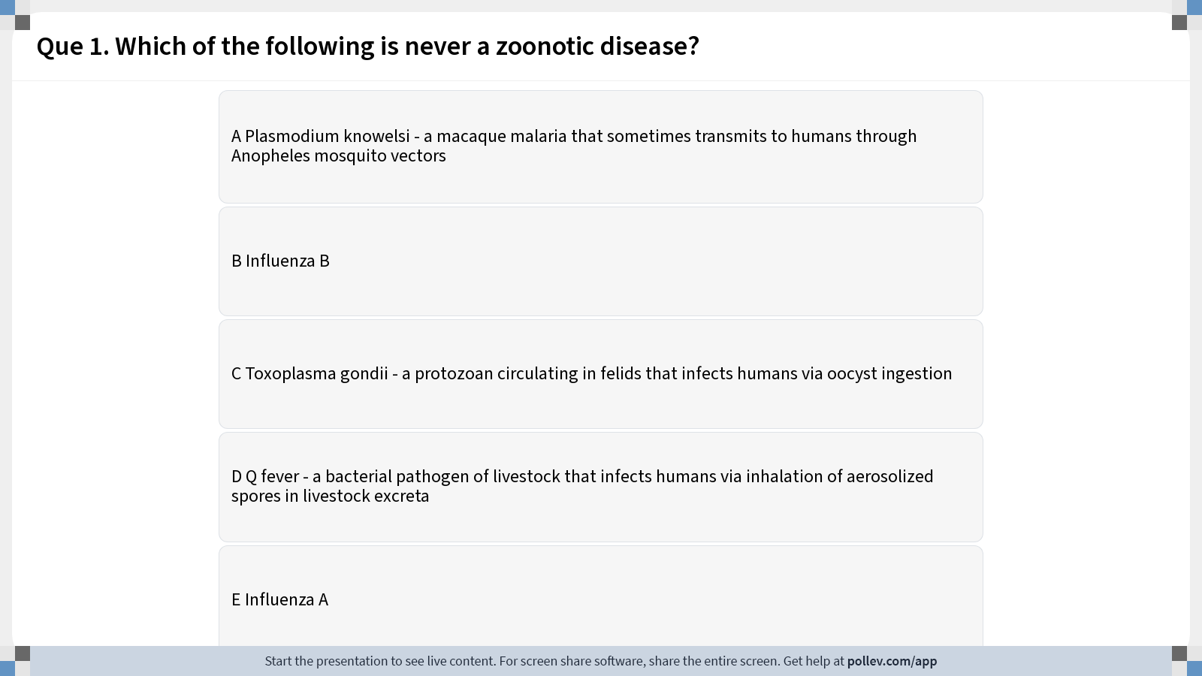
Notes:
Do not modify the notes in this section to avoid tampering with the Poll Everywhere activity. More info at polleverywhere.com/support Que 1. Which of the following is never a zoonotic disease?
https://www.polleverywhere.com/multiple_choice_polls/OUo3OjVxH7N5odJbdikIr?display_state=instructions&activity_state=opened&state=opened&flow=Instructor&onscreen=persist

Slide 17
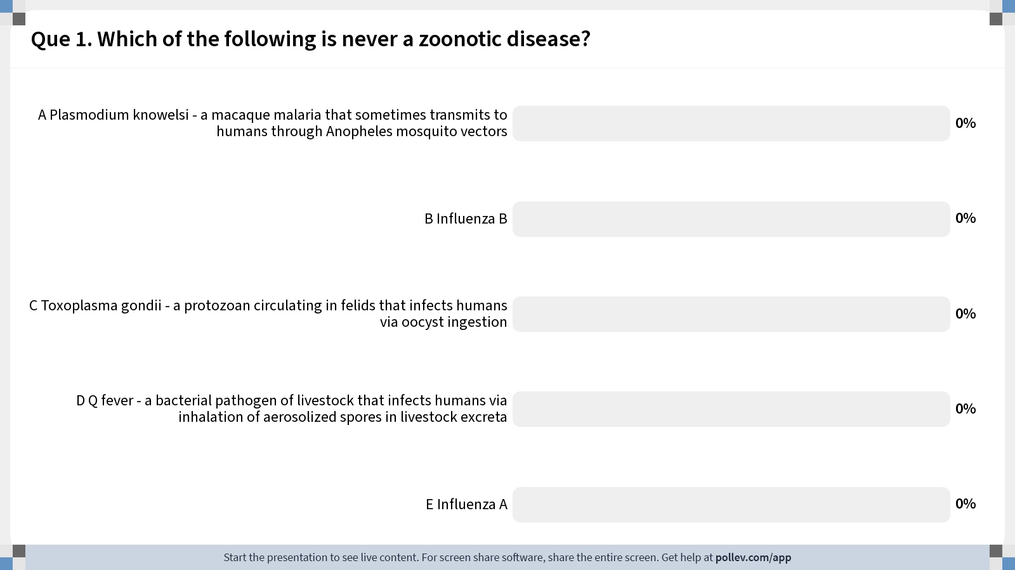
Notes:
Do not modify the notes in this section to avoid tampering with the Poll Everywhere activity. More info at polleverywhere.com/support Que 1. Which of the following is never a zoonotic disease?
https://www.polleverywhere.com/multiple_choice_polls/OUo3OjVxH7N5odJbdikIr?display_state=chart&activity_state=closed&state=closed&flow=Instructor&onscreen=persist

Slide 18
Notes:
Do not modify the notes in this section to avoid tampering with the Poll Everywhere activity. More info at polleverywhere.com/support Que 1. Which of the following is never a zoonotic disease?
https://www.polleverywhere.com/multiple_choice_polls/OUo3OjVxH7N5odJbdikIr?display_state=chart&activity_state=closed&display=correctness&state=closed&flow=Instructor&onscreen=persist

Slide 19
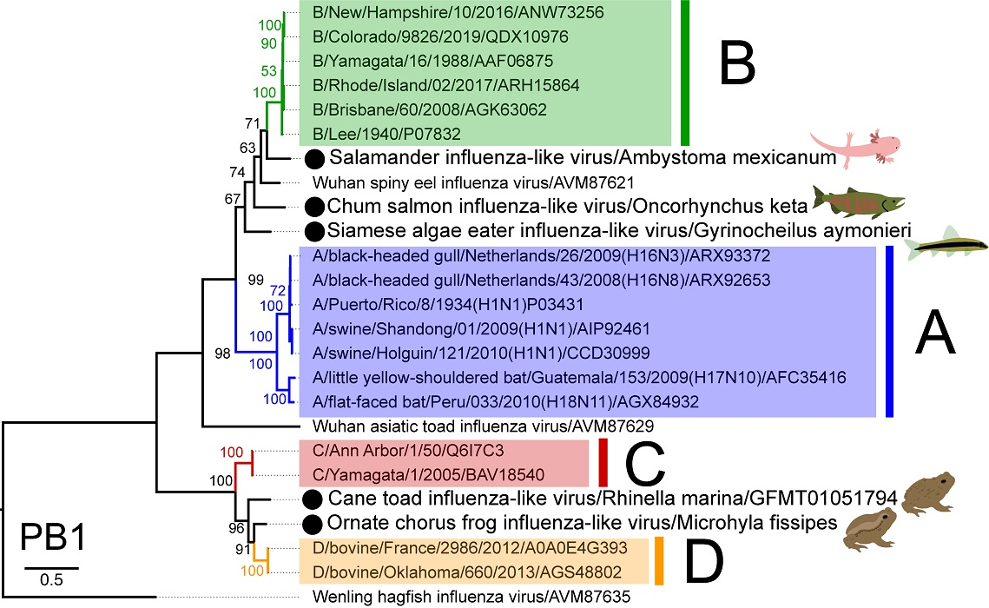
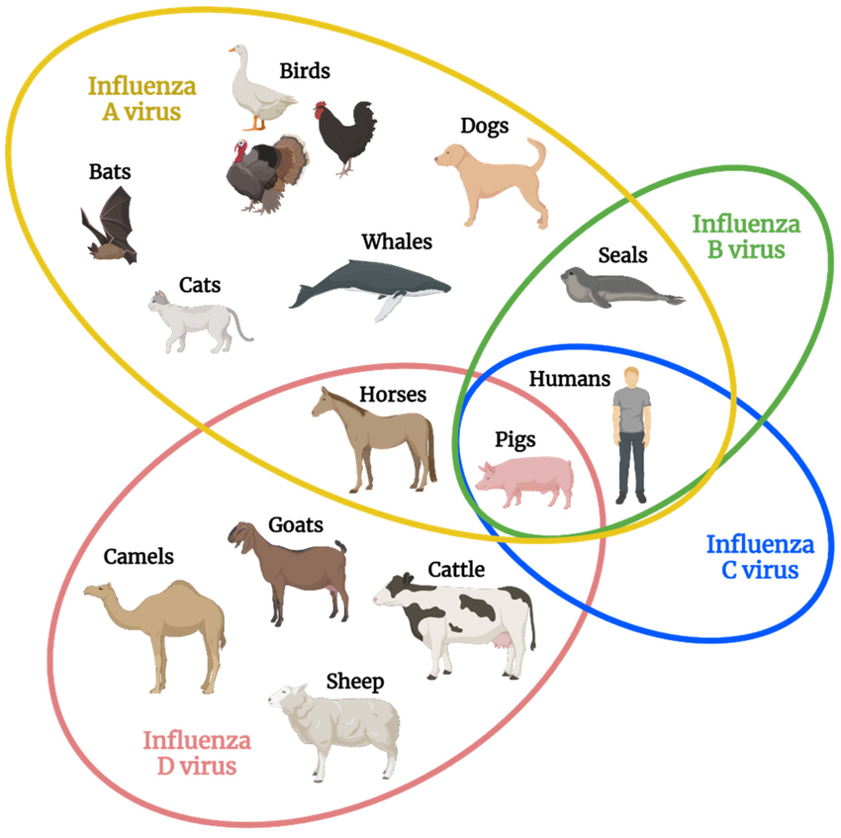
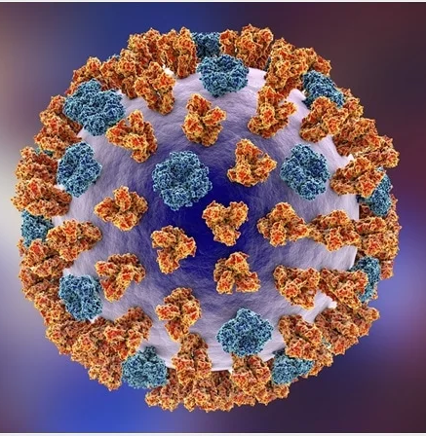
When is influenza zoonotic?
Parry et al. 2020. Viruses.
Transmits exclusively in humans
Stage V
Influenza
Skelton & Huber. 2022. Viruses.

Slide 20
Why do pathogens make us sick?

Slide 21
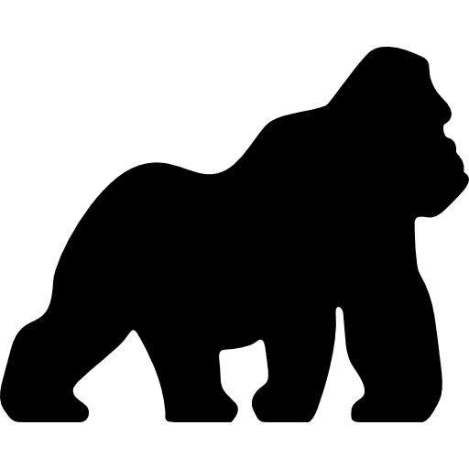
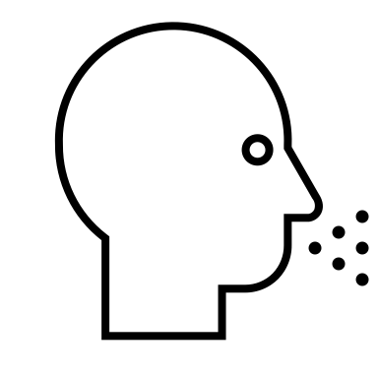

Why do pathogens make us sick?
A virus will evolve to maximize its capacity for between-host infections (R₀).
Alizon et al. 2008. J Evolutionary Biology
Anderson and May 1982. Parasitology.
Notes:
Typically, we predict that a virus will evolve traits that maximize its capacity for reproducing itself by infecting new hosts, achieving a baseline viral density within a single individual that produces sufficient virions in excretia – like the cough shown here – to go on to infect new hosts

Slide 22

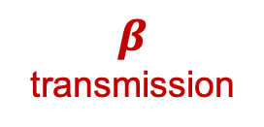
Why do pathogens make us sick?
A virus will evolve to maximize its capacity for between-host infections (R₀).
$$β$$
transmission
Alizon et al. 2008. J Evolutionary Biology
Anderson and May 1982. Parasitology.
Notes:
Typically, we predict that a virus will evolve traits that maximize its capacity for reproducing itself by infecting new hosts, achieving a baseline viral density within a single individual that produces sufficient virions in excretia – like the cough shown here – to go on to infect new hosts

Slide 23
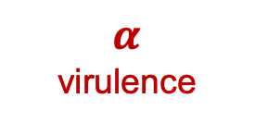
Why do pathogens make us sick?
A virus will evolve to maximize its capacity for between-host infections (R₀).
$$α$$
virulence
$$β$$
transmission
Mechanisms that promote transmission may also enhance virulence to the host.
Alizon et al. 2008. J Evolutionary Biology
Anderson and May 1982. Parasitology.
Notes:
Typically, we predict that a virus will evolve traits that maximize its capacity for reproducing itself by infecting new hosts, achieving a baseline viral density within a single individual that produces sufficient virions in excretia – like the cough shown here – to go on to infect new hosts

Slide 24
Why do pathogens make us sick?
A virus will evolve to maximize its capacity for between-host infections (R₀).
Virulence, then, is a by-product of a pathogen’s need to transmit for reproduction!
$$α$$
virulence
$$β$$
transmission
Mechanisms that promote transmission may also enhance virulence to the host.
Alizon et al. 2008. J Evolutionary Biology
Anderson and May 1982. Parasitology.
Notes:
Typically, we predict that a virus will evolve traits that maximize its capacity for reproducing itself by infecting new hosts, achieving a baseline viral density within a single individual that produces sufficient virions in excretia – like the cough shown here – to go on to infect new hosts

Slide 25
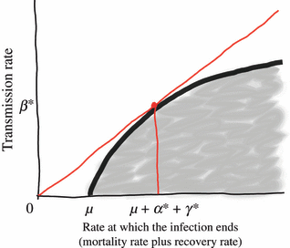
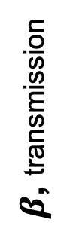
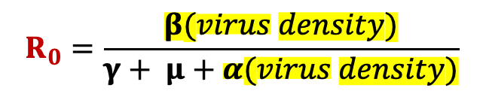
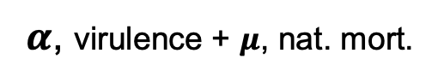
Why do pathogens make us sick?
A virus will evolve to maximize its capacity for between-host infections (R₀).
$$α$$
virulence
As a result, we predict the evolution of “optimal virulence.”
$$β$$
transmission
$β$, transmission
Mechanisms that promote transmission may also enhance virulence to the host.
$α$, virulence + $μ$, nat. mort.
infections created
$$R_{0}=\frac{β(virus density)}{γ+ μ+α(virus density)}$$
Alizon et al. 2008. J Evolutionary Biology
Anderson and May 1982. Parasitology.
infections lost
Notes:
Typically, we predict that a virus will evolve traits that maximize its capacity for reproducing itself by infecting new hosts, achieving a baseline viral density within a single individual that produces sufficient virions in excretia – like the cough shown here – to go on to infect new hosts

Slide 26
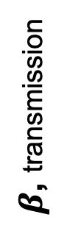
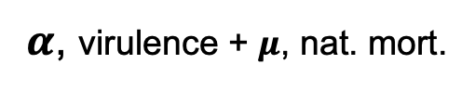
Why do pathogens make us sick?
A virus will evolve to maximize its capacity for between-host infections (R₀).
$$α$$
virulence
As a result, we predict the evolution of “optimal virulence.”
$$β$$
transmission
$β$, transmission
Note that originally Anderson and May (1982) represented this link to virus density as acting on the disease recovery rate, though it is now more commonly expressed as a function of virulence!
Mechanisms that promote transmission may also enhance virulence to the host.
$α$, virulence + $μ$, nat. mort.
infections created
$$R_{0}=\frac{β(virus density)}{γ+ μ+α(virus density)}$$
Alizon et al. 2008. J Evolutionary Biology
Anderson and May 1982. Parasitology.
infections lost
Notes:
Typically, we predict that a virus will evolve traits that maximize its capacity for reproducing itself by infecting new hosts, achieving a baseline viral density within a single individual that produces sufficient virions in excretia – like the cough shown here – to go on to infect new hosts

Slide 27
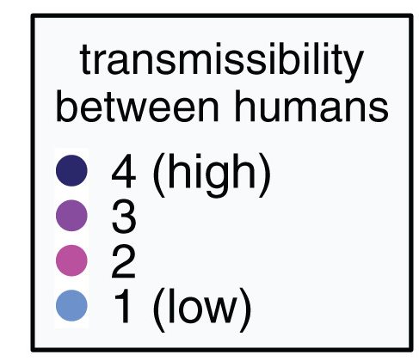
For zoonoses, virulence and transmission tradeoff to result in total death burden.
Guth et al. 2019. Phil Trans Roy Soc.
Guth et al. 2022. PNAS.
Notes:
Leading researchers to ask, are bats somehow special in their capacity as zoonotic hosts?

Slide 28
For zoonoses, virulence and transmission tradeoff to result in total death burden.
Guth et al. 2019. Phil Trans Roy Soc.
Guth et al. 2022. PNAS.
Notes:
Leading researchers to ask, are bats somehow special in their capacity as zoonotic hosts?

Slide 29
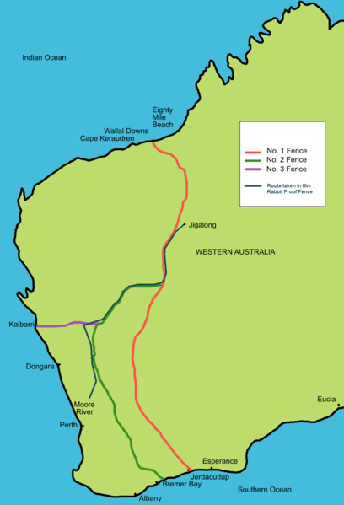
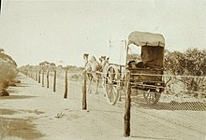
The virulence case study of rabbit Myxoma virus
1788: European rabbits brought to Australia as a food source
Rabbits quickly became feral and numbers soared.
1901: Australia constructed the famous “rabbit-proof fence” to attempt to keep rabbits out of agriculture in the West
Government looked to control measures, including biological controls in the 1930s.
Tried Myxoma virus, a highly virulent European poxvirus infecting rabbits. with a CFR >99%

Slide 30
The virulence case study of rabbit Myxoma virus
1788: European rabbits brought to Australia as a food source
Rabbits quickly became feral and numbers soared.
1901: Australia constructed the famous “rabbit-proof fence” to attempt to keep rabbits out of agriculture in the West.
Government looked to control measures, including biological controls in the 1930s.
Tried Myxoma virus, a highly virulent European poxvirus infecting rabbits. with a CFR >99%

Slide 31
The virulence case study of rabbit Myxoma virus
1788: European rabbits brought to Australia as a food source
Rabbits quickly became feral and numbers soared.
1901: Australia constructed the famous “rabbit-proof fence” to attempt to keep rabbits out of agriculture in the West.
Government looked to control measures, including biological controls in the 1930s.
Tried Myxoma virus, a highly virulent European poxvirus infecting rabbits. with a CFR >99%.

Slide 32
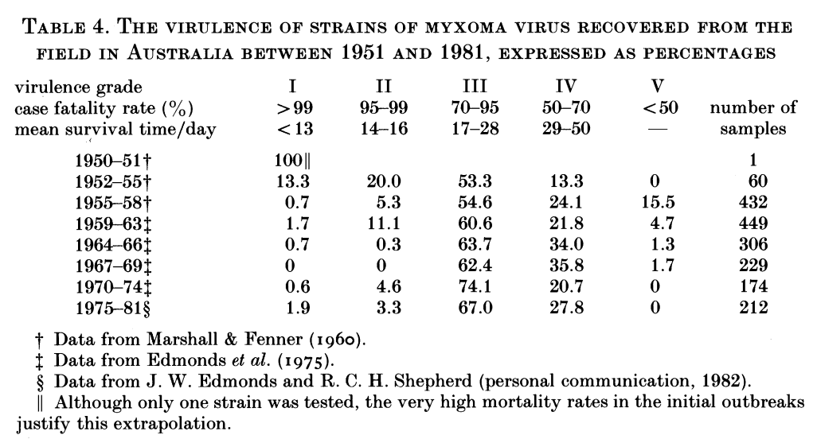
Myxoma virus evolved to intermediate virulence in just a single year.
Fenner 1983. Proc Roy Soc B

Slide 33
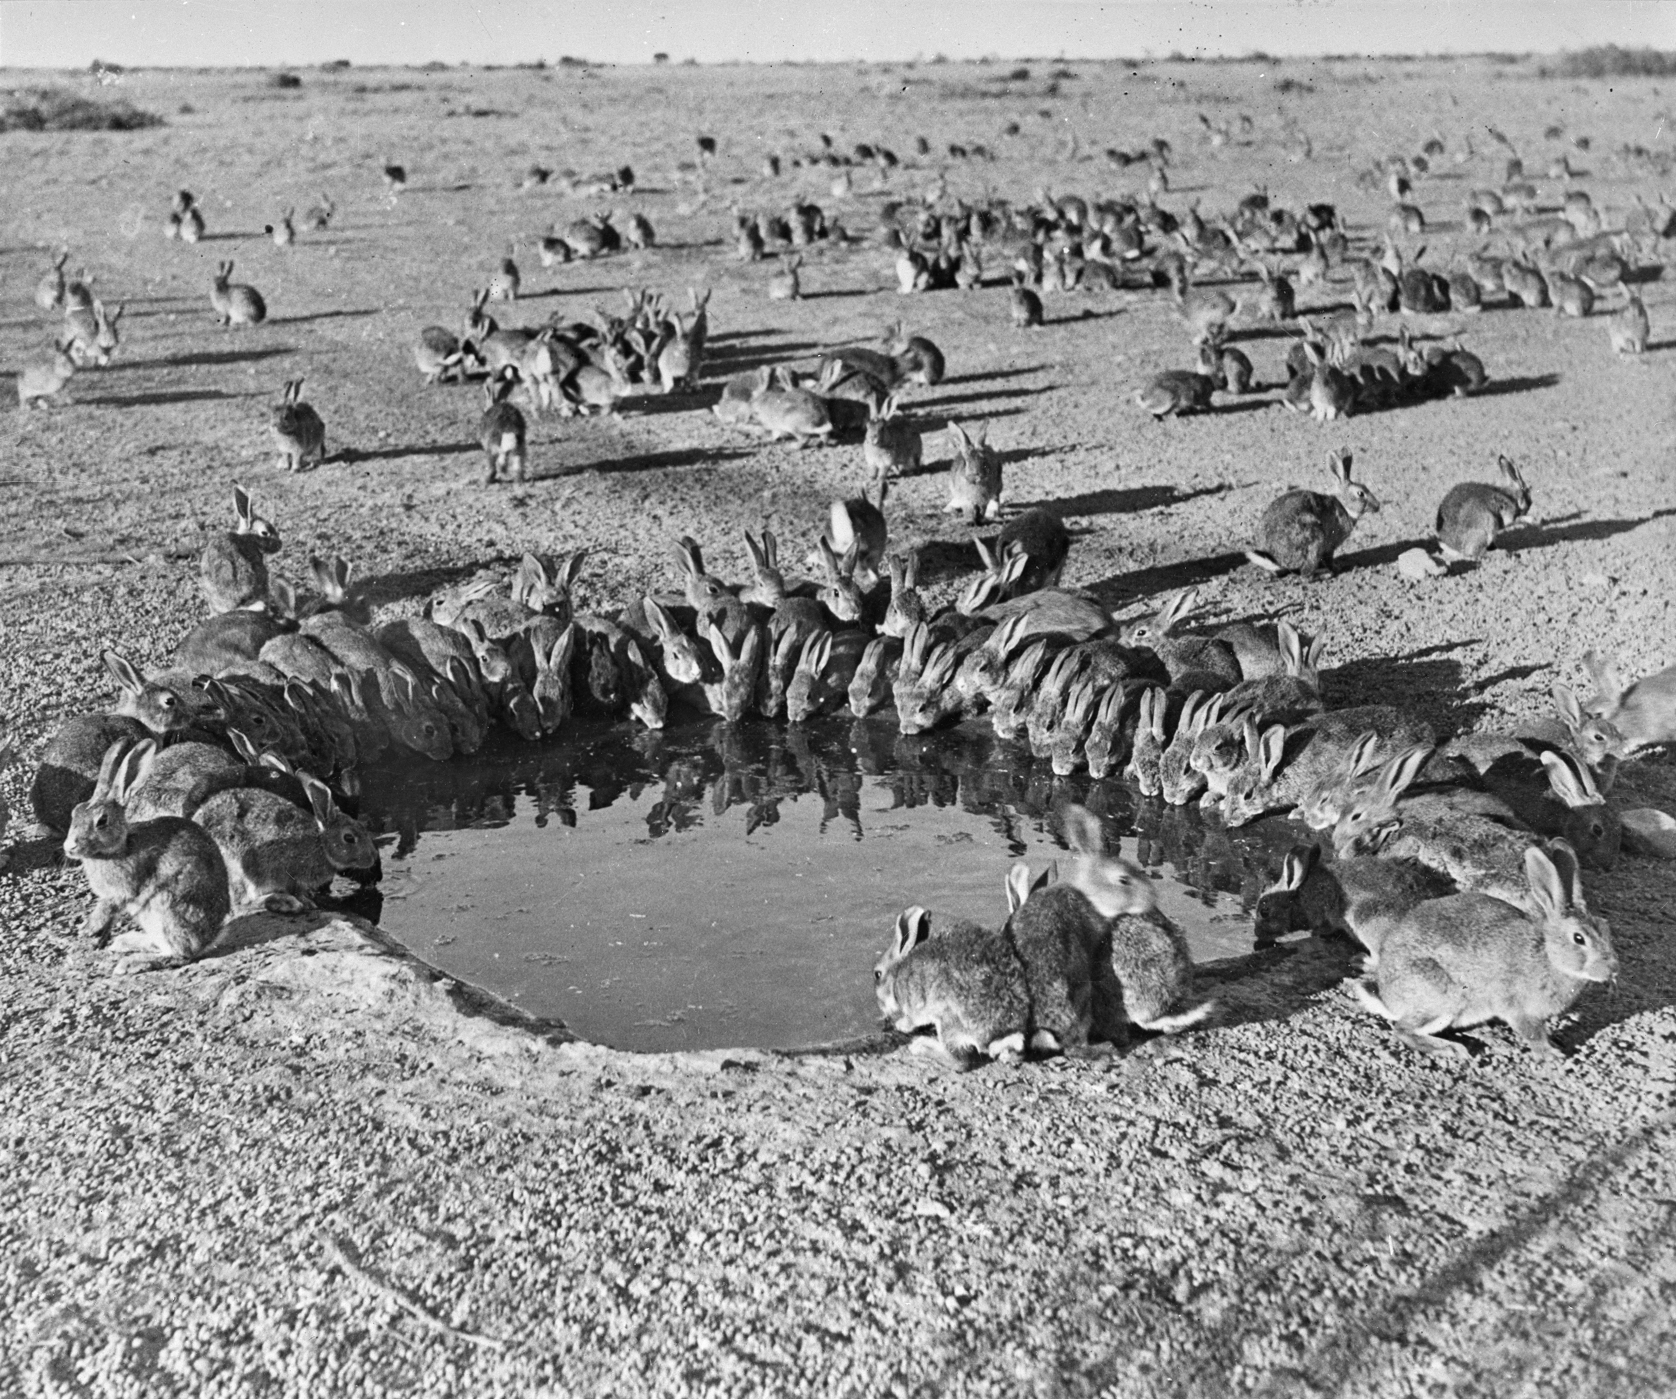
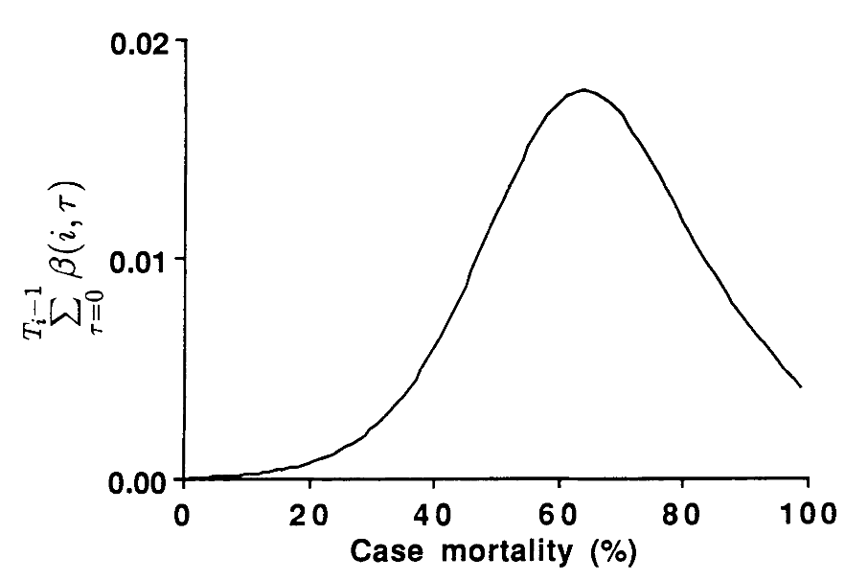
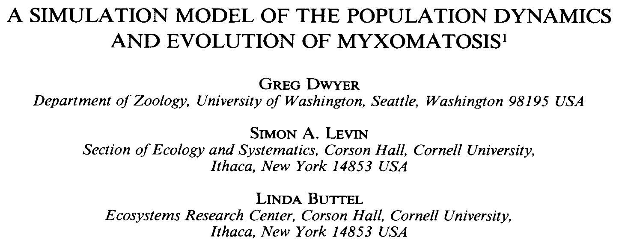
For Myxoma virus, intermediate virulence evolution resulted from optimization of the tradeoffs between virulence and transmission.
Cumulative transmission function, similar to R₀
Rabbits around a waterhole in the myxomatosis trial site on Wardang Island, Australia, 1938
Dwyer, Levin, and Buttel. 1990.
Ecological Monographs.

Slide 34
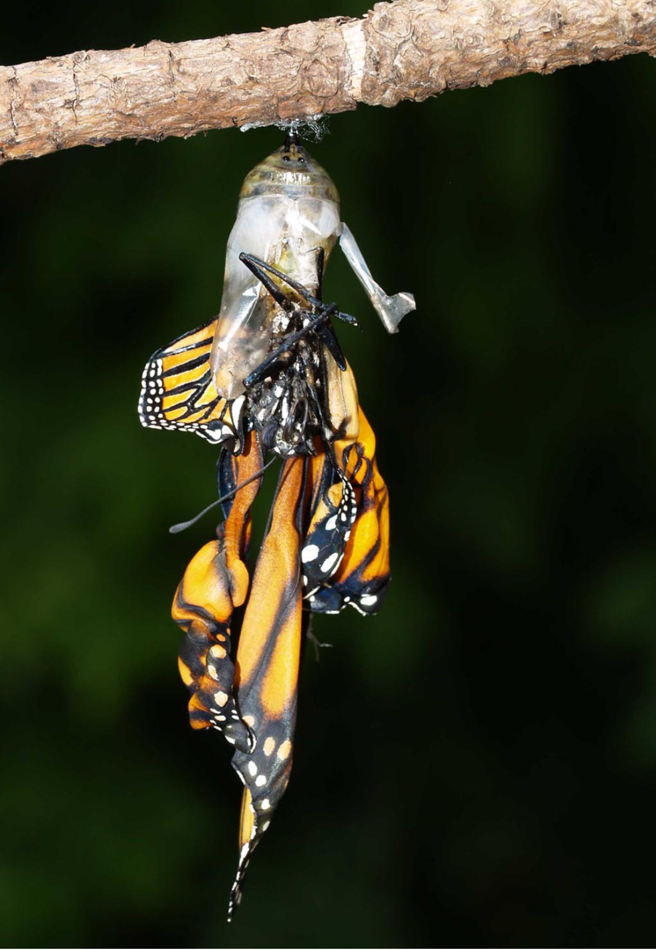
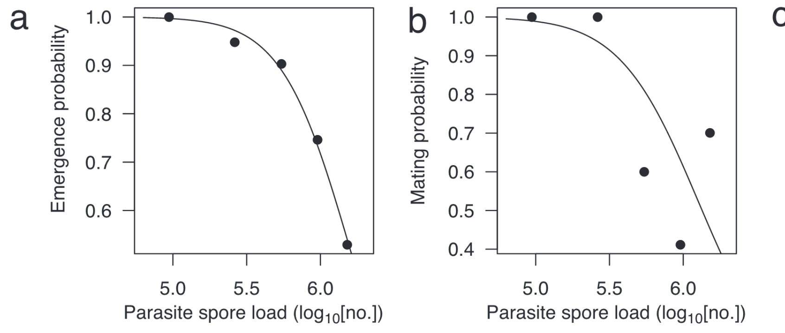
Another classic transmission-virulence tradeoff: parasites of monarch butterflies
Monarch butterflies infected with the protozoan parasite, Ophryocystis elektroscirrha, demonstrate reduced emergence and mating probabilities at higher parasite spore load (virulence).
de Roode et al. 2008. PNAS.

Slide 35
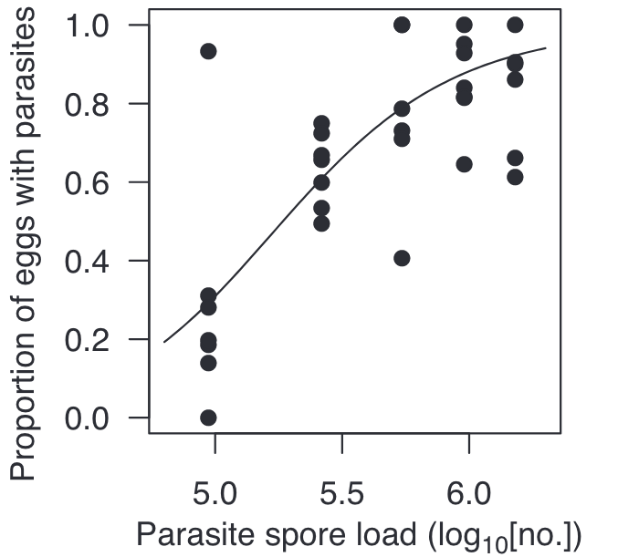
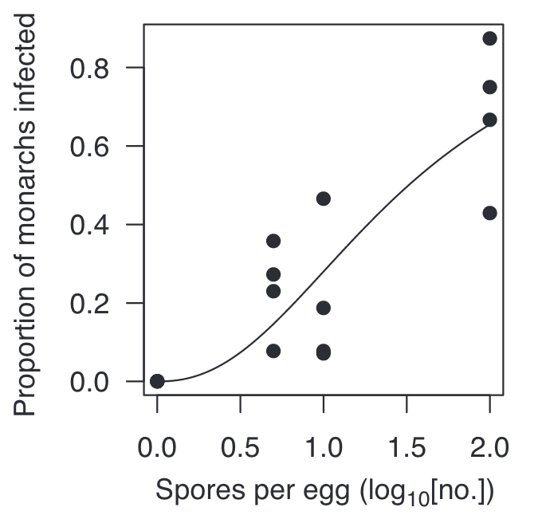
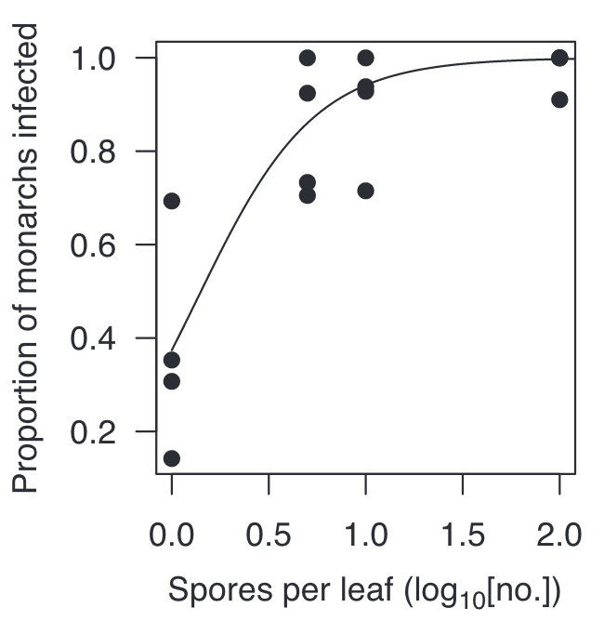
Another classic transmission-virulence tradeoff: parasites of monarch butterflies
Monarch butterflies infected with the protozoan parasite, Ophryocystis elektroscirrha, demonstrate reduced emergence and mating probabilities at higher parasite spore load (virulence).
On the flip side, higher parasite loads also led to increased transmission through higher proportions of monarch eggs that acquired spores and higher numbers of parasites per egg and milkweed leaf, which increased the probability of infection.
de Roode et al. 2008. PNAS.

Slide 36
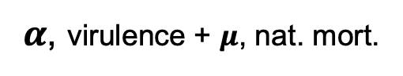

Another classic transmission-virulence tradeoff: parasites of monarch butterflies
Monarch butterflies infected with the protozoan parasite, Ophryocystis elektroscirrha, demonstrate reduced emergence and mating probabilities at higher parasite spore load (virulence).
On the flip side, higher parasite loads also led to increased transmission through higher proportions of monarch eggs that acquired spores and higher numbers of parasites per egg and milkweed leaf, which increased the probability of infection.
Parasite fitness is calculated to be maximized at intermediate spore load.
$β$, transmission
$α$, virulence + $μ$, nat. mort.
de Roode et al. 2008. PNAS.

Slide 37
Limitations of the tradeoff model
The ‘trade-off hypothesis’ offers an explanation for the disease inflicted by parasites and pathogens on their original hosts. While well-designed theoretically, it has not been historically well-supported empirically!
This is partly due to challenges arising from the difficulty of measuring (and defining) transmission and virulence.
Virulence is a fitness cost that the parasite inflicts on the host, but these can take diverse forms, with differing consequences for the evolution of virulence.
(e.g. fitness effects on reproduction vs. adult mortality)
Sometimes, virulence is the result of the host’s immune response, rather than the direct impact of the parasite itself, further complicating dynamics
In the case of zoonoses, the bulk of our measurements may be derived from a different host than the one in which the virus evolved
Many examples of cases in which transmission is decoupled from virulence, due to more complex transmission dynamics.
Ex: Ebola (transmission after death )
Ex: COVID (transmission high in the respiratory tract; morbidity low in the RT)

Slide 38
Limitations of the tradeoff model
The ‘trade-off hypothesis’ offers an explanation for the disease inflicted by parasites and pathogens on their original hosts. While well-designed theoretically, it has not been historically well-supported empirically!
This is partly due to challenges arising from the difficulty of measuring (and defining) transmission and virulence.
Virulence is a fitness cost that the parasite inflicts on the host, but these can take diverse forms, with differing consequences for the evolution of virulence.
For example: Fitness effects on reproduction vs. adult mortality
Sometimes, virulence is the result of the host’s immune response, rather than the direct impact of the parasite itself, further complicating dynamics
In the case of zoonoses, the bulk of our measurements may be derived from a different host than the one in which the virus evolved
Many examples of cases in which transmission is decoupled from virulence, due to more complex transmission dynamics.
Ex: Ebola (transmission after death )
Ex: COVID (transmission high in the respiratory tract; morbidity low in the RT)

Slide 39
Limitations of the tradeoff model
The ‘trade-off hypothesis’ offers an explanation for the disease inflicted by parasites and pathogens on their original hosts. While well-designed theoretically, it has not been historically well-supported empirically!
This is partly due to challenges arising from the difficulty of measuring (and defining) transmission and virulence.
Virulence is a fitness cost that the parasite inflicts on the host, but these can take diverse forms, with differing consequences for the evolution of virulence.
For example: Fitness effects on reproduction vs. adult mortality
Sometimes, virulence is the result of the host’s immune response, rather than the direct impact of the parasite itself, further complicating dynamics
In the case of zoonoses, the bulk of our measurements may be derived from a different host than the one in which the virus evolved
Many examples of cases in which transmission is decoupled from virulence, due to more complex transmission dynamics.
Ex: Ebola (transmission after death )
Ex: COVID (transmission high in the respiratory tract; morbidity low in the RT)

Slide 40
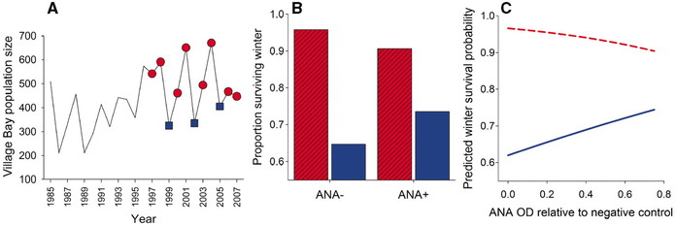
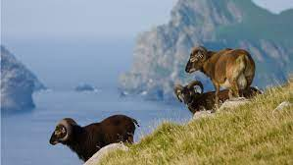
Sometimes, virulence is the result of the host’s immune response, rather than the direct impact of the parasite itself
Self-reactive antibodies (ANA) promote survival by downregulating worms in crash years but impede survival via immunopathology in peak years!
Graham et al. 2010. Science.

Slide 41
Limitations of the tradeoff model
The ‘trade-off hypothesis’ offers an explanation for the disease inflicted by parasites and pathogens on their original hosts. While well-designed theoretically, it has not been historically well-supported empirically!
This is partly due to challenges arising from the difficulty of measuring (and defining) transmission and virulence.
Virulence is a fitness cost that the parasite inflicts on the host, but these can take diverse forms, with differing consequences for the evolution of virulence.
For example: Fitness effects on reproduction vs. adult mortality
Sometimes, virulence is the result of the host’s immune response, rather than the direct impact of the parasite itself, further complicating dynamics
In the case of zoonoses, the bulk of our measurements may be derived from a different host than the one in which the virus evolved
Many examples of cases in which transmission is decoupled from virulence, due to more complex transmission dynamics.
Ex: Ebola (transmission after death )
Ex: COVID (transmission high in the respiratory tract; morbidity low in the RT)

Slide 42
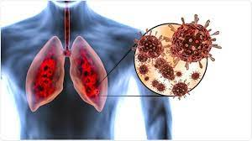
Limitations of the tradeoff model
The ‘trade-off hypothesis’ offers an explanation for the disease inflicted by parasites and pathogens on their original hosts. While well-designed theoretically, it has not been historically well-supported empirically!
This is partly due to challenges arising from the difficulty of measuring (and defining) transmission and virulence.
Virulence is a fitness cost that the parasite inflicts on the host, but these can take diverse forms, with differing consequences for the evolution of virulence.
For example: Fitness effects on reproduction vs. adult mortality
Sometimes, virulence is the result of the host’s immune response, rather than the direct impact of the parasite itself, further complicating dynamics
In the case of zoonoses, the bulk of our measurements may be derived from a different host than the one in which the virus evolved
Many examples of cases in which transmission is decoupled from virulence, due to more complex transmission dynamics.
Ex: COVID (transmission high in the respiratory tract; morbidity low in the RT)

Slide 43
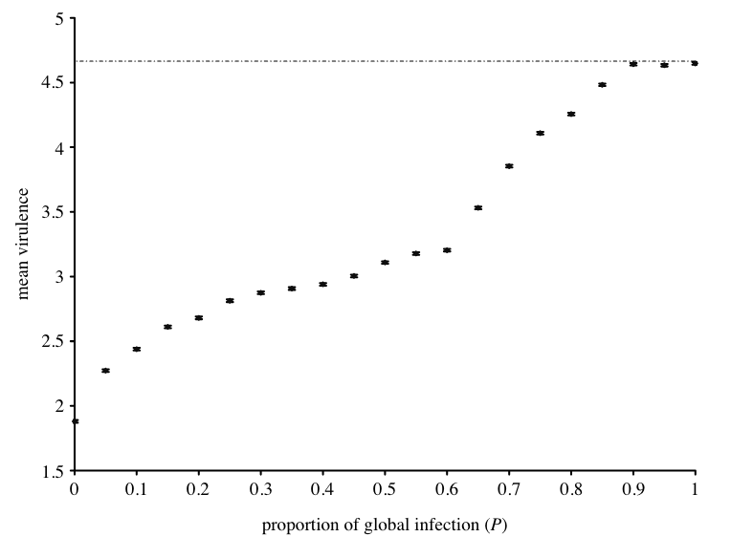
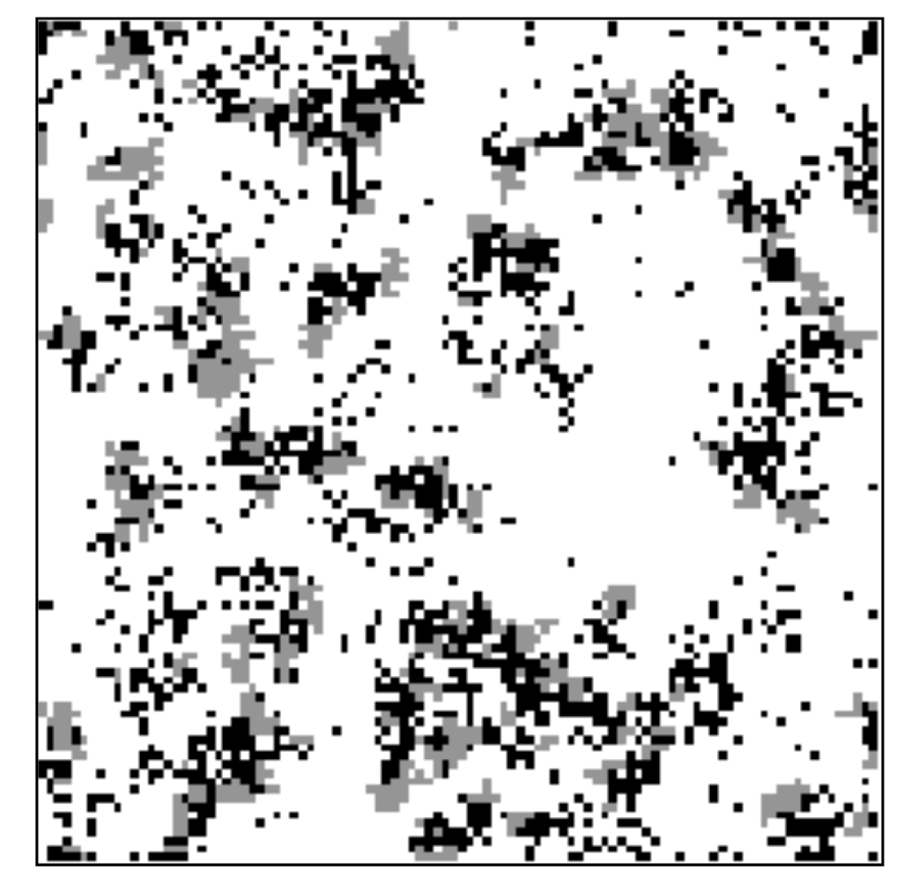
Spatial structuring generally favors reduced pathogen virulence.
Boots and Sasaki. 1999. Proc Roy Soc B.

Slide 44
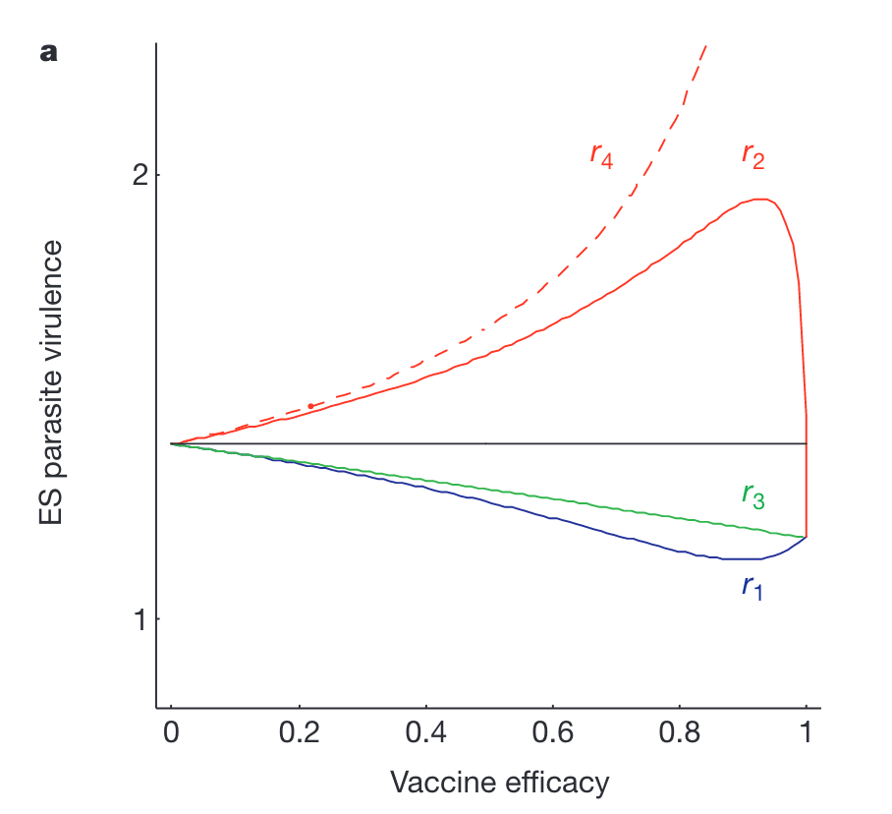
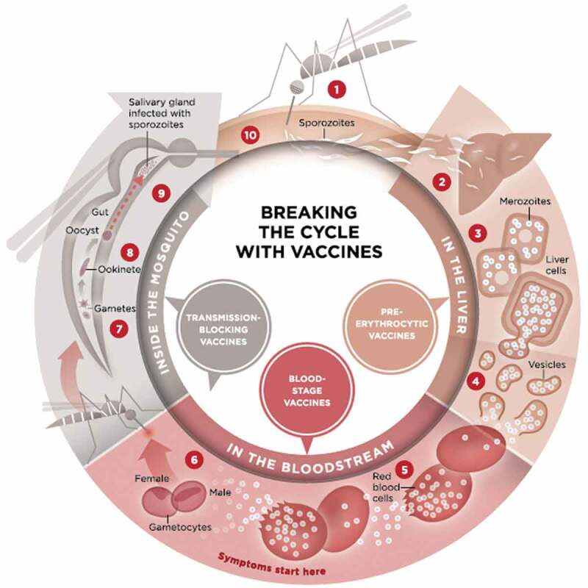
Imperfect vaccination can support the evolution of higher virulence, depending on the lifestage of the pathogen that is targeted.
Malaria vaccines
anti-growth rate vaccines
transmission-blocking vaccines
infection blocking vaccines
transmission-blocking vaccines
infection blocking vaccines
anti-growth rate vaccines
Gandon et al. 2001. Nature.

Slide 45
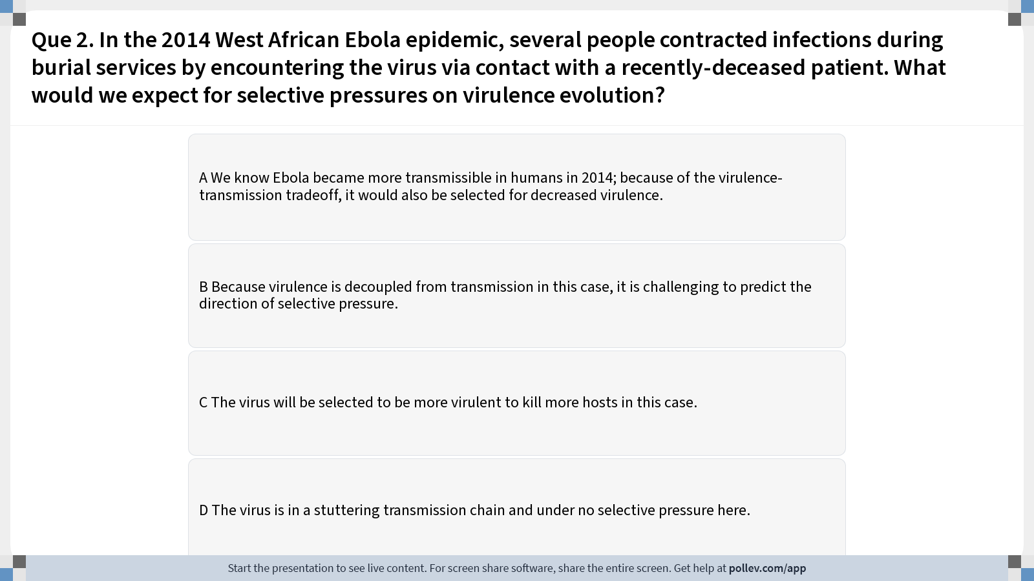
Notes:
Do not modify the notes in this section to avoid tampering with the Poll Everywhere activity. More info at polleverywhere.com/support Que 2. In the 2014 West African Ebola epidemic, several people contracted infections during burial services by encountering the virus via contact with a recently-deceased patient. What would we expect for selective pressures on virulence evolution?
https://www.polleverywhere.com/multiple_choice_polls/q1kS1z1nIzNd7O9kzBdHs?display_state=instructions&activity_state=opened&state=opened&flow=Instructor&onscreen=persist

Slide 46
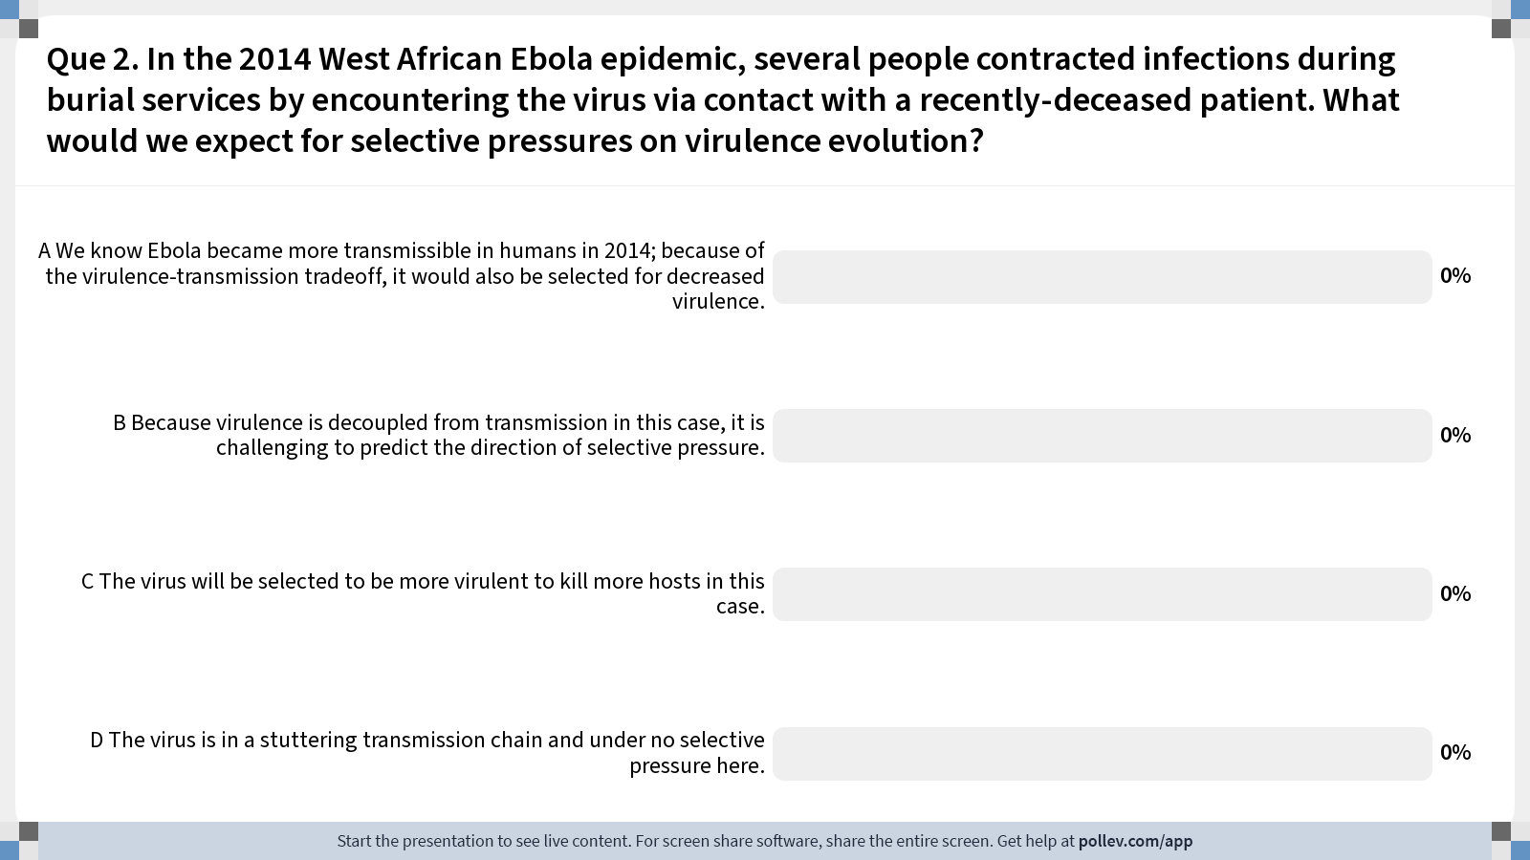
Notes:
Do not modify the notes in this section to avoid tampering with the Poll Everywhere activity. More info at polleverywhere.com/support Que 2. In the 2014 West African Ebola epidemic, several people contracted infections during burial services by encountering the virus via contact with a recently-deceased patient. What would we expect for selective pressures on virulence evolution?
https://www.polleverywhere.com/multiple_choice_polls/q1kS1z1nIzNd7O9kzBdHs?display_state=chart&activity_state=closed&state=closed&flow=Instructor&onscreen=persist

Slide 47
Notes:
Do not modify the notes in this section to avoid tampering with the Poll Everywhere activity. More info at polleverywhere.com/support Que 2. In the 2014 West African Ebola epidemic, several people contracted infections during burial services by encountering the virus via contact with a recently-deceased patient. What would we expect for selective pressures on virulence evolution?
https://www.polleverywhere.com/multiple_choice_polls/q1kS1z1nIzNd7O9kzBdHs?display_state=chart&activity_state=closed&display=correctness&state=closed&flow=Instructor&onscreen=persist

Slide 48
Disease dynamics in the broader community

Slide 49
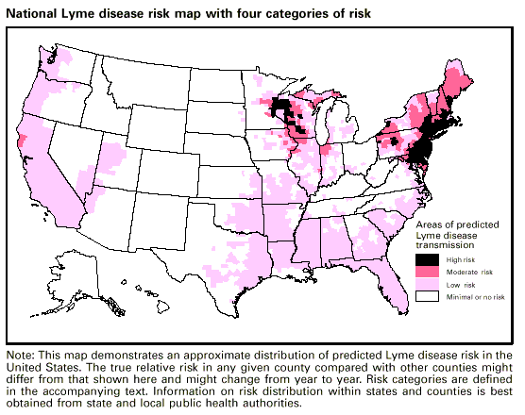
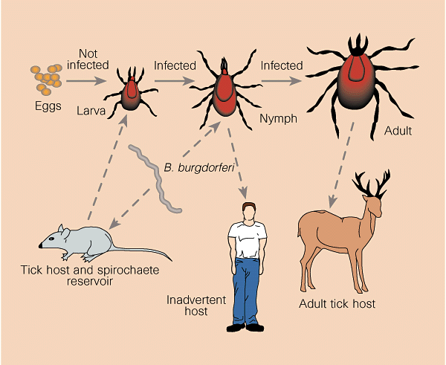
Disease dynamics in the broader community
Example: Lyme Disease
Lyme disease is a vector-borne disease caused by the bacterium, Borrellia burgdoferi, vectored by Ixodes especially Ixodes scapularis) ticks.
Nymph ticks are borne in the spring, feed on small mammal hosts through the summer, then reproduce (particularly on deer) in the fall before going dormant in the winter.
Human cases are largely concentrated in the spring and summer and result from infected tick bites.
Barbour and Zuckert 1997. Nature.

Slide 50
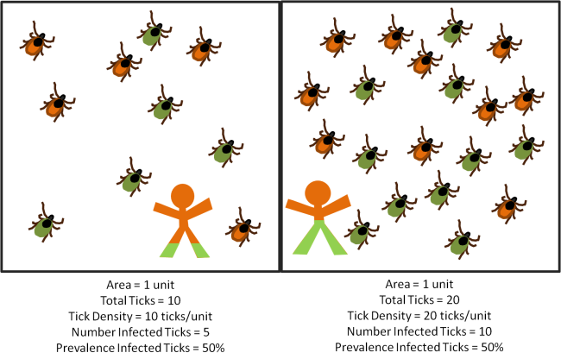
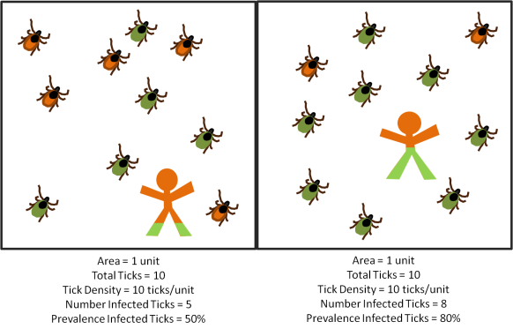
Human infection probability varies with both the density of infected ticks and the prevalence of Lyme in the tick population.
Scenario 1: Density of infected ticks
Scenario 2: Prevalence of Lyme in tick population
lime = infected with Lyme
parasiteecology.wordpress.com

Slide 51
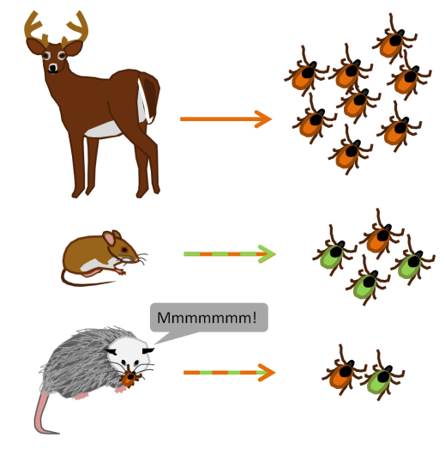
The broader wildlife community impacts Lyme disease risk for humans
Wildlife hosts vary in the extent to which they offer blood meals to ticks, thereby modulating tick abundance.
Wildlife hosts also vary in their permissibility to B. burgdoferi infection.
lime = infected with Lyme
parasiteecology.wordpress.com

Slide 52
The dilution effect highlights buffering effects of biodiversity on disease transmission.
While a popular concept, it only holds in select cases!

Slide 53
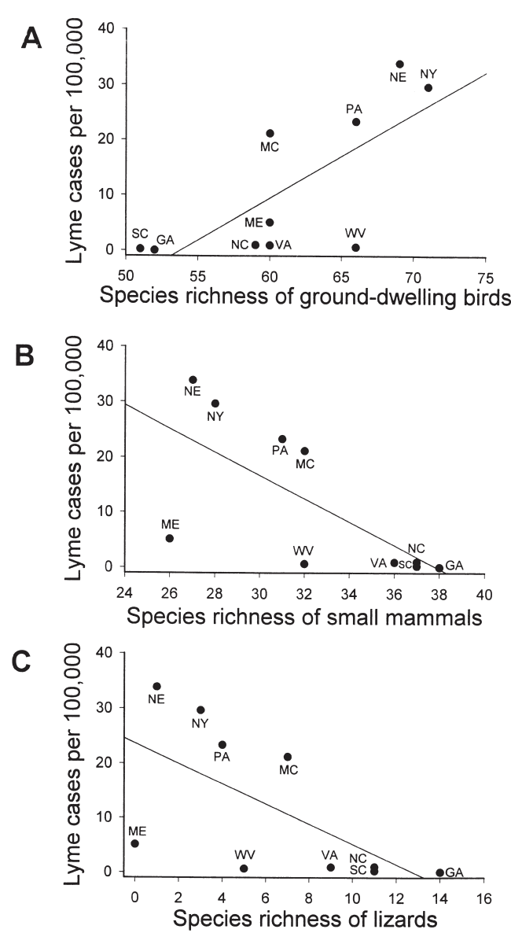
The dilution effect highlights buffering effects of biodiversity on disease transmission.
While a popular concept, it only holds in select cases!
In the case of Lyme, many examples demonstrate a
negative correlation between host biodiversity and Lyme prevalence.
Ostfeld and Keesing. 2000. Conservation Biology.

Slide 54
The dilution effect highlights buffering effects of biodiversity on disease transmission.
While a popular concept, it only holds in select cases!
In the case of Lyme, many examples demonstrate a
negative correlation between host biodiversity and Lyme prevalence.
Patterns depend on the context of the wildlife community!

Slide 55
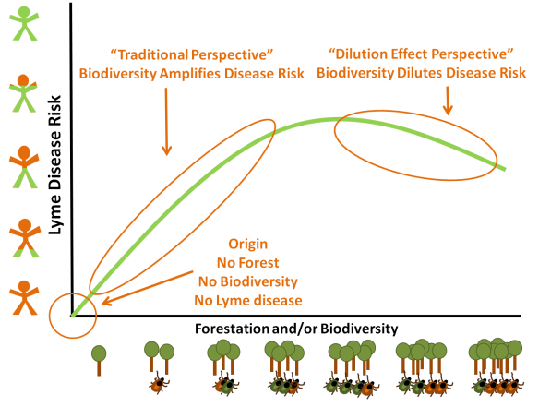
Human infection probability varies with both the density of infected ticks and the prevalence of Lyme in the tick population.
parasiteecology.wordpress.com

Slide 56
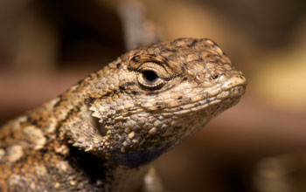
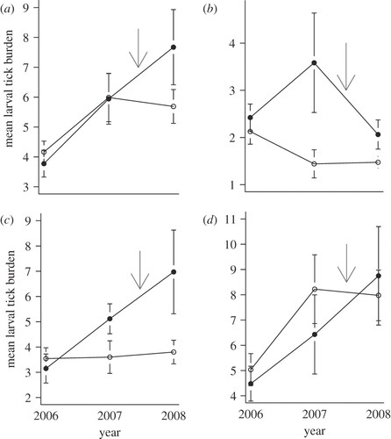
“Zooprophylaxis” is the diversion of pathogen-transmitting arthropods from humans to animals
Tick burden on female (left) and male (right) woodrats in Marin County, CA following removal of western fence lizard (Sceloporus occidentalis) at the end of the 2007 year in experimental (solid) and control (open circle) plots
Sceloporus occidentalis
Swei et al. 2011. Proc Roy Soc B.

Slide 57
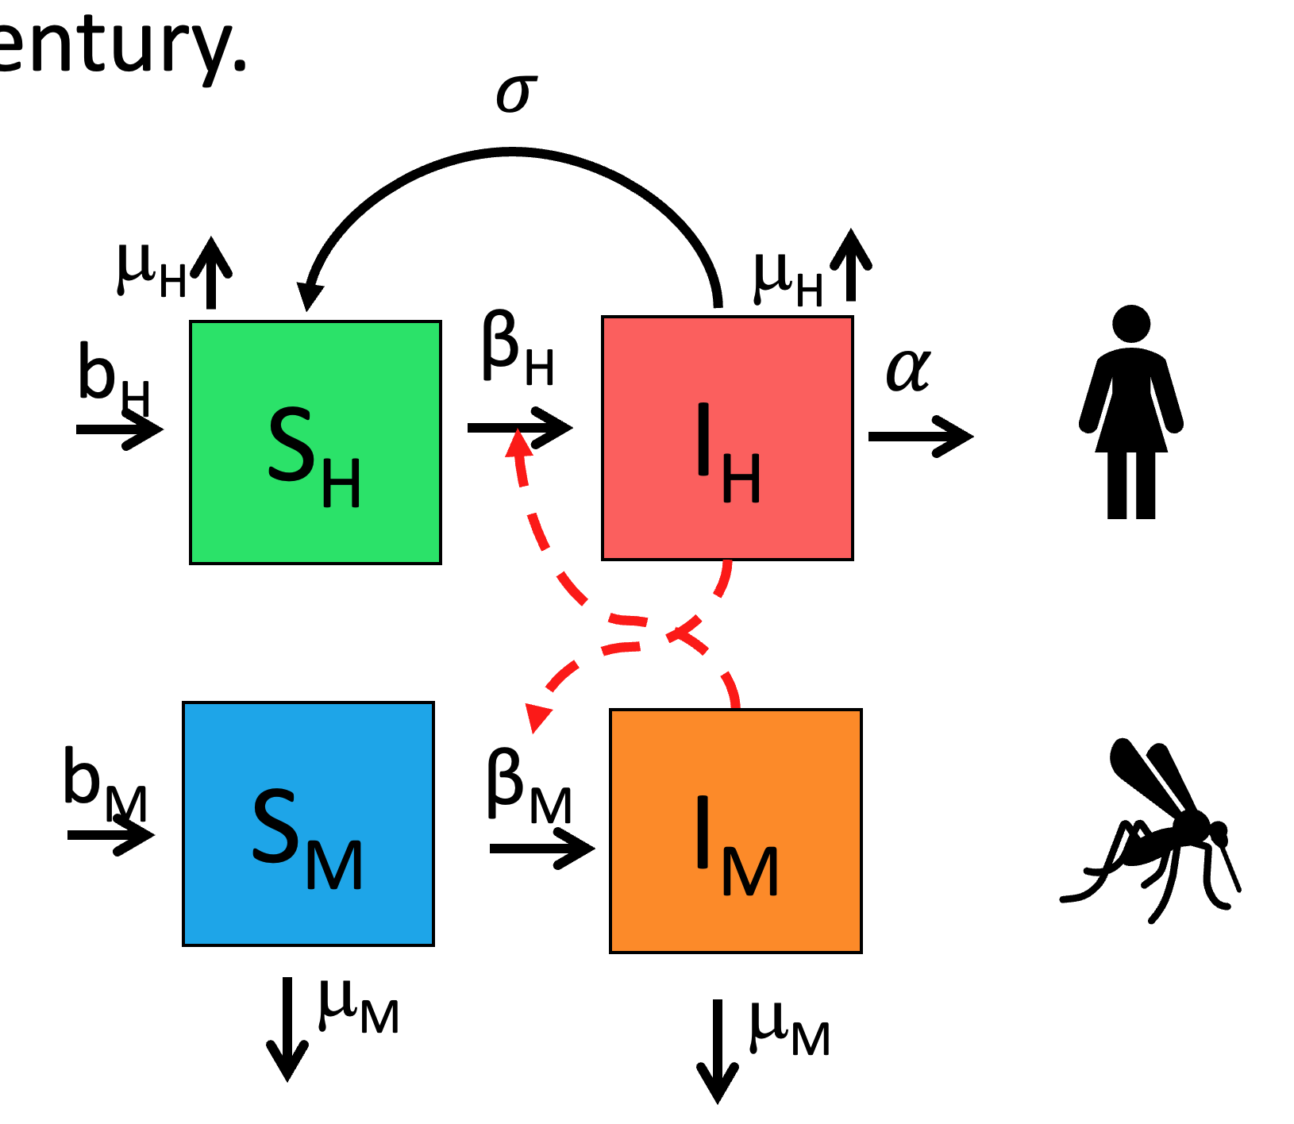

“Zooprophylaxis” has been suggested for malaria control – but only works in cases by which livestock are used as bait to draw mosquitoes closer to insecticides.
Black, red, green, blue = 0, 20, 40 or 60% chance of being killed as a result of feeding on animals
Asale et al. 2017. Malaria Journal

Slide 58


Understanding the underlying transmission dynamics of the system can help predict how wildlife biodiversity might amplify or dilute human disease risk in different contexts.
Results from an extended Ross-McDonald malaria model
Meta-analysis of biodiversity impacts on 69 common human pathogens
amplification
spurious dilution
true dilution
disease eradication
Wood et al. 2014. Ecology

Slide 59

Notes:
Do not modify the notes in this section to avoid tampering with the Poll Everywhere activity. More info at polleverywhere.com/support Que. 3. Imagine a forest with endemic Lyme disease and a high population of deer. What outcome would you expect if the deer were experimentally removed, but the increase in grass availability leads to an explosion in the population of white-footed mice?
https://www.polleverywhere.com/multiple_choice_polls/7Vbq8vcrOpJUJYeOHg01y?display_state=instructions&activity_state=opened&state=opened&flow=Instructor&onscreen=persist

Slide 60

Notes:
Do not modify the notes in this section to avoid tampering with the Poll Everywhere activity. More info at polleverywhere.com/support Que. 3. Imagine a forest with endemic Lyme disease and a high population of deer. What outcome would you expect if the deer were experimentally removed, but the increase in grass availability leads to an explosion in the population of white-footed mice?
https://www.polleverywhere.com/multiple_choice_polls/7Vbq8vcrOpJUJYeOHg01y?display_state=chart&activity_state=closed&state=closed&flow=Instructor&onscreen=persist

Slide 61
Notes:
Do not modify the notes in this section to avoid tampering with the Poll Everywhere activity. More info at polleverywhere.com/support Que. 3. Imagine a forest with endemic Lyme disease and a high population of deer. What outcome would you expect if the deer were experimentally removed, but the increase in grass availability leads to an explosion in the population of white-footed mice?
https://www.polleverywhere.com/multiple_choice_polls/7Vbq8vcrOpJUJYeOHg01y?display_state=chart&activity_state=closed&display=correctness&state=closed&flow=Instructor&onscreen=persist

Slide 62

Ecosystem = communities interacting with the abiotic environment
individual
population
metapopulation
community
ecosystem
Notes:
And finally how multiple species interact with each other – and with the environment

Slide 63
Ecosystem = communities interacting with the abiotic environment
individual
population
fish
(x)
metapopulation
(t)
shark
(y)
community
How does fish abundance vary with changes in shark birth rates with temperature?
ecosystem
Notes:
And finally how multiple species interact with each other – and with the environment

Slide 64
Ecosystem = communities interacting with the abiotic environment
individual
population
There is often less emphasis on the box model approach and more of a conceptual model approach to explain the distribution and abundance of species in space and time
metapopulation
community
ecosystem
Notes:
At the bottom, there is the level of the individual. Since ecology concerns interactions of organisms with each other and the environment, here we means how an in individual interacts with the environment

Slide 65
Ecosystem = communities interacting with the abiotic environment
individual
population
There is often less emphasis on the box model approach and more of a conceptual model approach to explain the distribution and abundance of species in space and time
metapopulation
community
How do communities assemble?
Do they end up the same in different environments?
ecosystem
Notes:
At the bottom, there is the level of the individual. Since ecology concerns interactions of organisms with each other and the environment, here we means how an in individual interacts with the environment

Slide 66






What is a model?
an abstract representation of a phenomenon
Solar System
Climate
Human
Human Genetics
Human Disease
Species Distribution
Notes:
an abstract representation of a phenomenon

Slide 67


What is a model?
an abstract representation of a phenomenon
Human
Solar System
Mathematical
Human Genetics
Human Disease
Conceptual
Notes:
an abstract representation of a phenomenon

Slide 68
Community assembly is the study of the processes that shape the identity and abundance of species within ecological communities.

Slide 69
Community assembly is the study of the processes that shape the identity and abundance of species within ecological communities.
One process of community assembly is ecological succession.

Slide 70
One process of community assembly is ecological succession.
Succession is the process of change in the species structure of ecological communities with time.

Slide 71
One process of community assembly is ecological succession.
Succession is the process of change in the species structure of ecological communities with time.
Community begins with pioneer species, then develops with increasing complexity that self-reinforces to establish a climax community.

Slide 72

One process of community assembly is ecological succession.
Succession is the process of change in the species structure of ecological communities with time.
Community begins with pioneer species, then develops with increasing complexity that self-reinforces to establish a climax community.
Henry Chandler Cowles, a professor at the University of Chicago, developed the first formal concept of succession while observing vegetation on dunes of different ages at the Indiana Dunes. Differently aged dunes offered a proxy for time.

Slide 73

Primary succession occurs when species colonize a bare substrate.

Slide 74
Primary succession occurs when species colonize a bare substrate.
Continuum from “r-selected” $→$ “K-selected” species.

Slide 75


Primary succession occurs when species colonize a bare substrate.
K-selected species
r-selected species
$$\frac{dN}{dt}=rN\left(1−\frac{N}{K}\right)$$
Continuum from “r-selected” $→$ “K-selected” species.

Slide 76

Secondary succession occurs when an environmental disturbance displaces a climax community, but soil and nutrients are still retained.

Slide 77
Secondary succession occurs when an environmental disturbance displaces a climax community, but soil and nutrients are still retained.
Continuum from “r-selected” $→$ “K-selected” species.

Slide 78


Succession also occurs in microbial systems.
Here, the “K-selected” superior competitor eventually replaces the “r-selected” fast colonizer.
Wetherington et al. 2022. BMC Biology

Slide 79
Superorganisms vs. Loose Collections of Species
Frederic Clements (1916) argued that community succession was predictable and deterministic, much like ontogenetic development in individual organisms, moving always towards some superorganism.

Slide 80

Superorganisms vs. Loose Collections of Species
Frederic Clements (1916) argued that community succession was predictable and deterministic, much like ontogenetic development in individual organisms, moving always towards some superorganism.
Priority effects: inhibitory or facilitative priority effects occur when one species ”prepares” the environment for the next species in succession

Slide 81
Superorganisms vs. Loose Collections of Species
Frederic Clements (1916) argued that community succession was predictable and deterministic, much like ontogenetic development in individual organisms, moving always towards some superorganism.
Priority effects: inhibitory or facilitative priority effects occur when one species ”prepares” the environment for the next species in succession
Henry Gleason (1926) argued instead that chance favored the dispersal of nearby species into available habitat for succession, leading to stochastic assembly of communities
Closer to Cowles’ original thinking

Slide 82

The Intermediate Disturbance Hypothesis states that species diversity should be maximized at levels of intermediate disturbance in which both r-selected and K-selected species can coexist.
r-selected species dominate
K-selected species dominate
Connell 1978. Science.

Slide 83


The Intermediate Disturbance Hypothesis states that species diversity should be maximized at levels of intermediate disturbance in which both r-selected and K-selected species can coexist.
Heron Island, Australia
r-selected species dominate
K-selected species dominate
Sometimes it seems to be correct!
Connell 1978. Science.

Slide 84


The Intermediate Disturbance Hypothesis states that species diversity should be maximized at levels of intermediate disturbance in which both r-selected and K-selected species can coexist.
Sometimes it is not so well-supported empirically!
r-selected species dominate
K-selected species dominate
Schwilk et al. 1997. Plant Ecology

Slide 85
What is a model?
The IDH gives an example of a model that is often wrong but still useful in generating testable hypotheses.
an abstract representation of a phenomenon
Solar System
Climate
Human
Human Genetics
Human Disease
Species Distribution
Notes:
an abstract representation of a phenomenon

Slide 86

Notes:
Do not modify the notes in this section to avoid tampering with the Poll Everywhere activity. More info at polleverywhere.com/support Que 4. Volvanic eruptions on Krakatoa, Indonesia in 1883 led to the complete destruction of a large part of the land mass and buried the remnant regions in ash and slag. What type of succession best describes the return of vegetation to these islands?
https://www.polleverywhere.com/multiple_choice_polls/ZzDvriECvH2R52qdCuYky?display_state=instructions&activity_state=opened&state=opened&flow=Instructor&onscreen=persist

Slide 87

Notes:
Do not modify the notes in this section to avoid tampering with the Poll Everywhere activity. More info at polleverywhere.com/support Que 4. Volvanic eruptions on Krakatoa, Indonesia in 1883 led to the complete destruction of a large part of the land mass and buried the remnant regions in ash and slag. What type of succession best describes the return of vegetation to these islands?
https://www.polleverywhere.com/multiple_choice_polls/ZzDvriECvH2R52qdCuYky?display_state=chart&activity_state=closed&state=closed&flow=Instructor&onscreen=persist

Slide 88
Notes:
Do not modify the notes in this section to avoid tampering with the Poll Everywhere activity. More info at polleverywhere.com/support Que 4. Volvanic eruptions on Krakatoa, Indonesia in 1883 led to the complete destruction of a large part of the land mass and buried the remnant regions in ash and slag. What type of succession best describes the return of vegetation to these islands?
https://www.polleverywhere.com/multiple_choice_polls/ZzDvriECvH2R52qdCuYky?display_state=chart&activity_state=closed&display=correctness&state=closed&flow=Instructor&onscreen=persist

Slide 89
The field of biogeography studies the geographical distribution of plants and animals

Slide 90

The field of biogeography studies the geographical distribution of plants and animals
Larger areas have more species!
$$S=cA^{z}$$
Preston 1964. Ecology

Slide 91
The field of biogeography studies the geographical distribution of plants and animals
Larger areas have more species!
$$S=cA^{z}$$
number of species
habitat area
Preston 1964. Ecology

Slide 92
The field of biogeography studies the geographical distribution of plants and animals
Larger areas have more species!
$$S=cA^{z}$$
slope of relationship in log-log space
number of species
habitat area
Preston 1964. Ecology

Slide 93
The field of biogeography studies the geographical distribution of plants and animals
Larger areas have more species!
$$S=cA^{z}$$
slope of relationship in log-log space
number of species
habitat area
constant based on unit of area
(standardizes to expected number of species per single unit area)
Preston 1964. Ecology

Slide 94
The field of biogeography studies the geographical distribution of plants and animals
Larger areas have more species!
The slope of the log-log relationship (z) will differ across diverse communities and ecosystems.
$$S=cA^{z}$$
Preston 1964. Ecology

Slide 95



The field of biogeography studies the geographical distribution of plants and animals
Plant species of the Galapagos islands
Larger areas have more species!
The slope of the log-log relationship (z) will differ across diverse communities and ecosystems.
$$S=cA^{z}$$
Bird species of Madagascar and the Comoros
Preston 1964. Ecology

Slide 96


The field of biogeography studies the geographical distribution of plants and animals.
Mammal species of western US national parks
Larger areas have more species!
The slope of the log-log relationship (z) will differ across diverse communities and ecosystems.
$$S=cA^{z}$$
Newmark 1986. Biological Journal of the Linnean Society.

Slide 97



We can use the species-area relationship (SAR) to build species accumulation curves to understand if we have representatively sampled a population in field studies.
No. species captured
No. individuals captured
Thompson 2003. Animal Ecology.

Slide 98

Building on the species-area relationship (SAR), MacArthur and Wilson proposed the theory of island biogeography.
MacArthur and Wilson. 1963. Evolution.
MacArthur and Wilson. 1967. The Theory of Island Biogeography.

Slide 99
Building on the species-area relationship (SAR), MacArthur and Wilson proposed the theory of island biogeography.
This theory offers a null model for the number of species found in a given habitat, predictable from both the size of the habitat and its distance from a source population.
MacArthur and Wilson. 1963. Evolution.
MacArthur and Wilson. 1967. The Theory of Island Biogeography.

Slide 100

The theory of island biogeography offers a null model for the number of species found in a given habitat, predictable from both the size of the habitat and its distance from a source population.
The equilibrium number of species in
an “island” habitat is reached when:
the rate of immigration = the rate of extinction
Immigration
Extinction
MacArthur and Wilson. 1963. Evolution.
MacArthur and Wilson. 1967. The Theory of Island Biogeography.

Slide 101
The theory of island biogeography offers a null model for the number of species found in a given habitat, predictable from both the size of the habitat and its distance from a source population.
Species area-effect: Larger islands have lower extinction rates because they provide more habitat to sustain more species. Allee effects reduced at larger population sizes.
The equilibrium number of species in
an “island” habitat is reached when:
the rate of immigration = the rate of extinction
Immigration
Extinction
N=100
N=10
MacArthur and Wilson. 1963. Evolution.
MacArthur and Wilson. 1967. The Theory of Island Biogeography.

Slide 102
The theory of island biogeography offers a null model for the number of species found in a given habitat, predictable from both the size of the habitat and its distance from a source population.
Distance effect: Closer islands have higher immigration rates because it’s easier for organisms to disperse across short distances.
Species area-effect: Larger islands have lower extinction rates because they provide more habitat to sustain more species. Allee effects reduced at larger population sizes.
The equilibrium number of species in
an “island” habitat is reached when:
the rate of immigration = the rate of extinction
Immigration
Extinction
N=100
N=10
MacArthur and Wilson. 1963. Evolution.
MacArthur and Wilson. 1967. The Theory of Island Biogeography.

Slide 103

The theory of island biogeography offers a null model for the number of species found in a given habitat, predictable from both the size of the habitat and its distance from a source population.
Distance effect: Closer islands have higher immigration rates because it’s easier for organisms to disperse across short distances.
Species area-effect: Larger islands have lower extinction rates because they provide more habitat to sustain more species. Allee effects reduced at larger population sizes.
The equilibrium number of species in
an “island” habitat is reached when:
the rate of immigration = the rate of extinction
Immigration
Extinction
N=100
N=10
MacArthur and Wilson. 1963. Evolution.
MacArthur and Wilson. 1967. The Theory of Island Biogeography.

Slide 104
The theory of island biogeography offers a null model for the number of species found in a given habitat, predictable from both the size of the habitat and its distance from a source population.
Distance effect: Closer islands have higher immigration rates because it’s easier for organisms to disperse across short distances.
Species area-effect: Larger islands have lower extinction rates because they provide more habitat to sustain more species. Allee effects reduced at larger population sizes.
The equilibrium number of species in
an “island” habitat is reached when:
the rate of immigration = the rate of extinction
Immigration
Extinction
turnover rate for far-small
S*: far-small
MacArthur and Wilson. 1963. Evolution.
MacArthur and Wilson. 1967. The Theory of Island Biogeography.

Slide 105
The theory of island biogeography offers a null model for the number of species found in a given habitat, predictable from both the size of the habitat and its distance from a source population.
Distance effect: Closer islands have higher immigration rates because it’s easier for organisms to disperse across short distances.
Species area-effect: Larger islands have lower extinction rates because they provide more habitat to sustain more species. Allee effects reduced at larger population sizes.
The equilibrium number of species in
an “island” habitat is reached when:
the rate of immigration = the rate of extinction
Immigration
Extinction
S*: far-small
S*: close-large
S*: far-large
S*: close-small

Slide 106

The theory of island biogeography offers a null model for the number of species found in a given habitat, predictable from both the size of the habitat and its distance from a source population.
Distance effect: Closer islands have higher immigration rates because it’s easier for organisms to disperse across short distances.
The equilibrium number of species in
an “island” habitat is reached when:
the rate of immigration = the rate of extinction
Species area-effect: Larger islands have lower extinction rates because they provide more habitat to sustain more species. Allee effects reduced at larger population sizes.
$$I\left(S\right)=E\left(S\right)$$
Immigration
Extinction

Slide 107

The theory of island biogeography offers a null model for the number of species found in a given habitat, predictable from both the size of the habitat and its distance from a source population.
Distance effect: Closer islands have higher immigration rates because it’s easier for organisms to disperse across short distances.
The equilibrium number of species in
an “island” habitat is reached when:
the rate of immigration = the rate of extinction
Species area-effect: Larger islands have lower extinction rates because they provide more habitat to sustain more species. Allee effects reduced at larger population sizes.
$$I\left(S\right)=E\left(S\right)$$
Immigration
Extinction
$$E(S)={Se}^{−εA}$$
fit parameter scaling effect of area on extinction
area of habitat
number of species on island

Slide 108

The theory of island biogeography offers a null model for the number of species found in a given habitat, predictable from both the size of the habitat and its distance from a source population.
Distance effect: Closer islands have higher immigration rates because it’s easier for organisms to disperse across short distances.
The equilibrium number of species in
an “island” habitat is reached when:
the rate of immigration = the rate of extinction
Species area-effect: Larger islands have lower extinction rates because they provide more habitat to sustain more species. Allee effects reduced at larger population sizes.
$$I\left(S\right)=E\left(S\right)$$
$$I(S)={i\left(P−S\right)e}^{−φd}$$
Immigration
Extinction
$$E(S)={Se}^{−εA}$$
distance from island to source population
immigration rate
number of species on island
area of habitat
number of species on island
fit parameter scaling effect of area on extinction
total number of species in pool
fit parameter governing distance decay on immigration rate

Slide 109
The theory of island biogeography offers a null model for the number of species found in a given habitat, predictable from both the size of the habitat and its distance from a source population.
Distance effect: Closer islands have higher immigration rates because it’s easier for organisms to disperse across short distances.
The equilibrium number of species in
an “island” habitat is reached when:
the rate of immigration = the rate of extinction
Species area-effect: Larger islands have lower extinction rates because they provide more habitat to sustain more species. Allee effects reduced at larger population sizes.
$$I\left(S\right)=E\left(S\right)$$
$$I(S)={i\left(P−S\right)e}^{−φd}$$
Immigration
Extinction
$$E(S)={Se}^{−εA}$$
distance from island to source population
immigration rate
number of species on island
area of habitat
number of species on island
fit parameter scaling effect of area on extinction
total number of species in pool
fit parameter governing distance decay on immigration rate

Slide 110


The theory of island biogeography offers a null model for the number of species found in a given habitat, predictable from both the size of the habitat and its distance from a source population.
The equilibrium number of species in
an “island” habitat is reached when:
the rate of immigration = the rate of extinction
$$I\left(S\right)=E\left(S\right)$$
Immigration
Extinction
$$S^{∗}=\frac{iPe^{εA}}{ie^{εA}+e^{φd}}$$
MacArthur and Wilson. 1963. Evolution.
MacArthur and Wilson. 1967. The Theory of Island Biogeography.

Slide 111
The theory of island biogeography offers a null model for the number of species found in a given habitat, predictable from both the size of the habitat and its distance from a source population.
The equilibrium number of species in
an “island” habitat is reached when:
the rate of immigration = the rate of extinction
increases with number of species in source pool
increases with area of island
Immigration
Extinction
$$S^{∗}=\frac{iPe^{εA}}{ie^{εA}+e^{φd}}$$
decreases with distance from with distance from mainland
equilibrium number of species
MacArthur and Wilson. 1963. Evolution.
MacArthur and Wilson. 1967. The Theory of Island Biogeography.

Slide 112
Extensions to the theory of island biogeography…
Species area-effect: Larger islands have lower extinction rates because they provide more habitat to sustain more species. Allee effects reduced at larger population sizes.
Distance effect: Closer islands have higher immigration rates because it’s easier for organisms to disperse across short distances.
The equilibrium number of species in
an “island” habitat is reached when:
the rate of immigration = the rate of extinction
Immigration
Extinction
N=100
N=10

Slide 113

Extensions to the theory of island biogeography…
Species area-effect: Larger islands have lower extinction rates because they provide more habitat to sustain more species. Allee effects reduced at larger population sizes.
Distance effect: Closer islands have higher immigration rates because it’s easier for organisms to disperse across short distances.
The equilibrium number of species in
an “island” habitat is reached when:
the rate of immigration = the rate of extinction
Immigration
Target effect: larger islands have higher immigration rates because they offer a bigger target to land on!
Extinction
Rescue effect: Closer islands have lower extinction rates because they can be repopulated from the mainland!

Slide 114



Wilson and Simberloff field-tested this theory in the Florida Keys!
Wilson and Simberloff identified seven mangrove islands in the Florida Keys varying in size from 11-18m in diameter and catalogued their fauna (all arthropods).
They also conducted surveys across the keys to quantify the entire possible “source” pool to the islands.
The experimental islands were then fumigated with methyl bromide at levels lethal to arthropods but not to plants.
They catalogued their progressive recolonization after fumigation, tracking its predictability based on size and distance of these islands to the source pool.
Simberloff. 1969. Ecology.
Wilson and Simberloff. 1969. Ecology.
Simberloff and Wilson. 1969. Ecology.

Slide 115


Wilson and Simberloff field-tested this theory in the Florida Keys!
Islands were recolonized to pre-defaunation levels rapidly, within a year!
Though the equilibrium number of species was the same, the identity was quite different – only about 40% similar to the original censuses.
Strong flyers recolonized first but were eventually replaced (outcompeted) by better competitors (typically ants) – in keeping with theories of faunal succession.
The islands farthest from the mainland were the slowest to recolonize.
Simberloff. 1969. Ecology.
Wilson and Simberloff. 1969. Ecology.
Simberloff and Wilson. 1969. Ecology.

Slide 116



In subsequent work, Simberloff demonstrated the area effect by actually removing entire chunks out of islands and censusing species!
log-log plot of island area and species count before and after land removal!
Pre-land removal species accumulation curves demonstrate that a sufficient quantity of biodiversity was sampled.
Simberloff. 1976. Ecology.

Slide 117


Island biogeography has greatly influenced the design of protected area reserves
Area effect:
Island size and resident, non-marine bird species number near New Guinea
Distance effect:
Island resident, non-marine bird species count by distance from New Guinea (standardized by area)
Diamond. 1975. Biological Conservation.

Slide 118



Island biogeography has greatly influenced the design of protected area reserves
Mammalian extirpations post-establishment by area size in western North American national parks
“SLOSS” debate
(1970s-1980s)
Reserve design estimated to protect the largest number of species based on island biogeography theory
Newmark. 1987. Nature.
Diamond. 1975. Biological Conservation.

Slide 119
Population Biology
Conservation Biology
Disease Ecology
Goal:
protect populations from extinction
Concept:
Minimum Viable Population size (MVP)
Approach:
protected area reserves
Goal:
protect populations from disease via pathogen extinction
Concept:
Critical Community Size (CCS)
Approach:
sanitation
vaccination

Slide 120
Biodiversity can be measured in several ways!

Slide 121
Biodiversity can be measured in several ways!
Landscape A
Site 1
Site 2
Whittaker. 1960. Ecological Monographs.

Slide 122

Biodiversity can be measured in several ways!
(here = 3)
$α$ – diversity = species richness, typically within a small specified region
Landscape A
Site 1
Site 2
(here = 4)
Whittaker. 1960. Ecological Monographs.

Slide 123

Biodiversity can be measured in several ways!
(here = 3)
$α$ – diversity = species richness, typically within a small specified region
Landscape A
Site 1
$γ$ – diversity = total species diversity in a the landscape (here = 5)
Site 2
(here = 4)
Whittaker. 1960. Ecological Monographs.

Slide 124


Biodiversity can be measured in several ways!
(here = 3)
(here = 1.67 or 2)
$α$ – diversity = species richness, typically within a small specified region
Landscape A
Site 1
$γ$ – diversity = total species diversity in a the landscape (here = 5)
Site 2
(here = 1.25 or 1)
$β$– diversity = ratio between landscape and local species diversity, either $\left(\frac{γ}{α}\right)$ or $\left(γ\text{−}α\right)$
Site 1 has lower $α$– diversity but higher $β$– diversity than site 2. Both are important!
(here = 4)
Whittaker. 1960. Ecological Monographs.

Slide 125

Biodiversity is concentrated in the tropics.
(terrestrial vertebrate diversity)
Mannion. 2014. Trends in Ecology & Evolution.

Slide 126
Biodiversity is concentrated in the tropics.
We still lack a satisfying model to explain why.
(terrestrial vertebrate diversity)
Mannion. 2014. Trends in Ecology & Evolution.

Slide 127
Biodiversity is concentrated in the tropics.
We still lack a satisfying model to explain why.
Some candidate hypotheses:
Geographical area hypothesis. More area in the tropics = more species… but there’s just as much area north of the tropics and fewer species!
Species-energy hypothesis. Increased solar energy at low latitudes causes increased net primary productivity (or photosynthesis) and drives accumulation of species up the food web…but offers a better prediction for abundance and biomass than for numbers of species.
Historical perturbation hypothesis. Polar regions have not yet recovered equilibrium species numbers after glaciation… but does not hold for marine systems, where the latitudinal gradient still exists…
Biotic interactions hypothesis. More species yield more species as processes of competition, predation, etc. are intensified in the tropics… but cannot provide the basal cause for the accumulation of more species to begin with!
Mannion. 2014. Trends in Ecology & Evolution.

Slide 128

Vector-borne and parasitic diseases are also concentrated in the tropics - where income is correspondingly low.
Bonds et al. 2012. PLoS Biology.

Slide 129
Why do we care about biodiversity?

